Slide 1
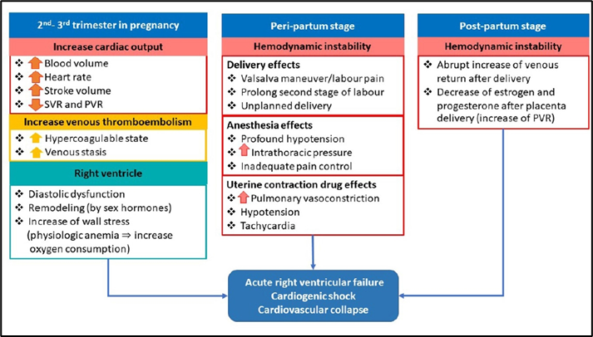
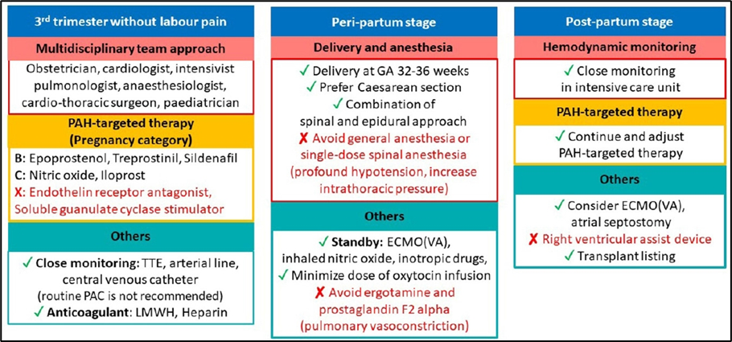
Easing the Tension
A Multidisciplinary Approach to Pulmonary Hypertension in Pregnancy
Emily Eruysal, MD, Marcia Chen, MD, Joe Bryant-Huppert, MD
DEPARTMENT OF ANESTHESIOLOGY, NEWYORK-PRESBYTERIAN HOSPITAL / WEILL CORNELL MEDICAL CENTER
Background
Pulmonary hypertension (PH) is characterized by elevated pulmonary artery pressure (PAP) and pulmonary vascular resistance (PVR)
Incidence: 1% of the global population
Diagnosed when PAP exceeds 20 mmHg
Maternal mortality rates of 30-50% due to poor tolerance of the physiologic changes (e.g. increased plasma volume and cardiac output)
Per the World Health Organization, pregnancy is contraindicated in PH patients due to the high risk of maternal cardiac events
Despite counseling, patients with PH may elect to continue their pregnancies
Case Presentation
31F G2P0010 at 33 weeks 2 days gestational age with PH as a sequelae of severe obstructive sleep apnea, obesity hypoventilation syndrome, and chronic thromboembolic disease was diagnosed with pre-eclampsia with severe features (PEC with SF)
Other PMH: HTN, asthma, BMI 55, type 2 diabetes mellitus
TTE: dilated right ventricle, mild PH
Right heart catheterization (RHC): PAP 53/25, mean PAP 34
On magnesium and insulin infusions antepartum
CD planned for following day
Obstetric Anesthesiology Consult/Multidisciplinary Planning
Delivery by CD with Neuraxial anesthesia
Avoid triggers to worsening PVR/PAP
Hypoxia, Hypercarbia, Acidosis, Pain, Anxiety, HTN, Myocardial depression
High flow nasal cannula (HFNC) vs continuous positive airway pressure (CPAP)
Arterial line: close BP monitoring, frequent arterial blood gas (ABG) draws
Careful use of prophylactic oxytocin
Recovery in the cardiac intensive care unit (CCU)
Neonatal resuscitation team at delivery
Contingency planning
availability of nitric oxide, inotropes
possible central line and pulmonary artery catheter
escalation of respiratory support
avoidance of carboprost/methylergonovine
Case Progression
Standard ASA monitors, ultrasound-guided radial arterial line, additional large bore access attained
Vasopressin infusion started prophylactically at 1U/h
Combined low-dose spinal-epidural (CSE) 1cc Hyperbaric Bupivacaine, Fentanyl, Morphine
Epidural slowly dosed 2% Lidocaine w/epi to achieve bilateral T4 level
HFNC titrated to PaO₂ on ABG
Continued magnesium infusion postpartum; continued insulin infusion until delivery
Oxytocin infusion started after delivery of anterior shoulder
Transferred to CCU for recovery, diuresis for worsening PH and volume overload
Discharged on post-operative day 7 with resolution of PH on RHC
Discussion
Recent studies have shown a decline in maternal mortality among pregnant women with well-controlled PH, ranging 9-25%
Management: supplemental oxygen, diuretics, and anticoagulation
Targeted therapy may include endothelin receptor antagonists, prostacyclin analogs, and phosphodiesterase-5 inhibitors
Key Points
CD preferred over labor to avoid acute increases in PVR
Neuraxial anesthesia preferred over general anesthesia
Strongly consider invasive monitoring with arterial line
ICU must be available for recovery
Contingency planning for acute decompensation: central access with pulmonary artery catheter (PAC) placement, escalation of respiratory support, inotropic support, and pulmonary dilators
Multidisciplinary planning between maternal fetal medicine, obstetric anesthesiology, cardiology, and neonatology is imperative for safe delivery
Figure 1. Pathophysiology of cardiovascular collapse in pregnant patients with PH during pregnancy. SVR: systemic vascular resistance; PVR: pulmonary vascular resistance. (Phoophiboon 2021)
Figure 3. Critical care management for pregnant patients with pulmonary arterial hypertension (PAH) TTE: transthoracic echocardiography; LMWH: low molecular weight heparin; ECMO: extracorporeal membrane oxygenation; VA: veno-arterial. (Phoophiboon 2021)
References
1. Afify H et al. Integr Blood Press Control 2022. PMID: 35401013; PMCID: PMC8985908.
2. Dunlap B et al. Am Fam Physician. PMID: 27637122.
3. Hemnes AR et al. Pulm Circ. 2015. PMID: 26401246
4. Krishnan, S et al. Current Pulmonology Reports. 10. 10.1007/s13665-021-00275-1. 5. Thomas E et al. JAHA. 2017. PMID: 29066439
6. Phoophiboon V et al. Acute Crit Care. 2021;36(4):286-293. doi: 10.4266/acc.2021.00458
Figure 2. Intraoperative anesthetic record during Cesarean section

