Slide 1
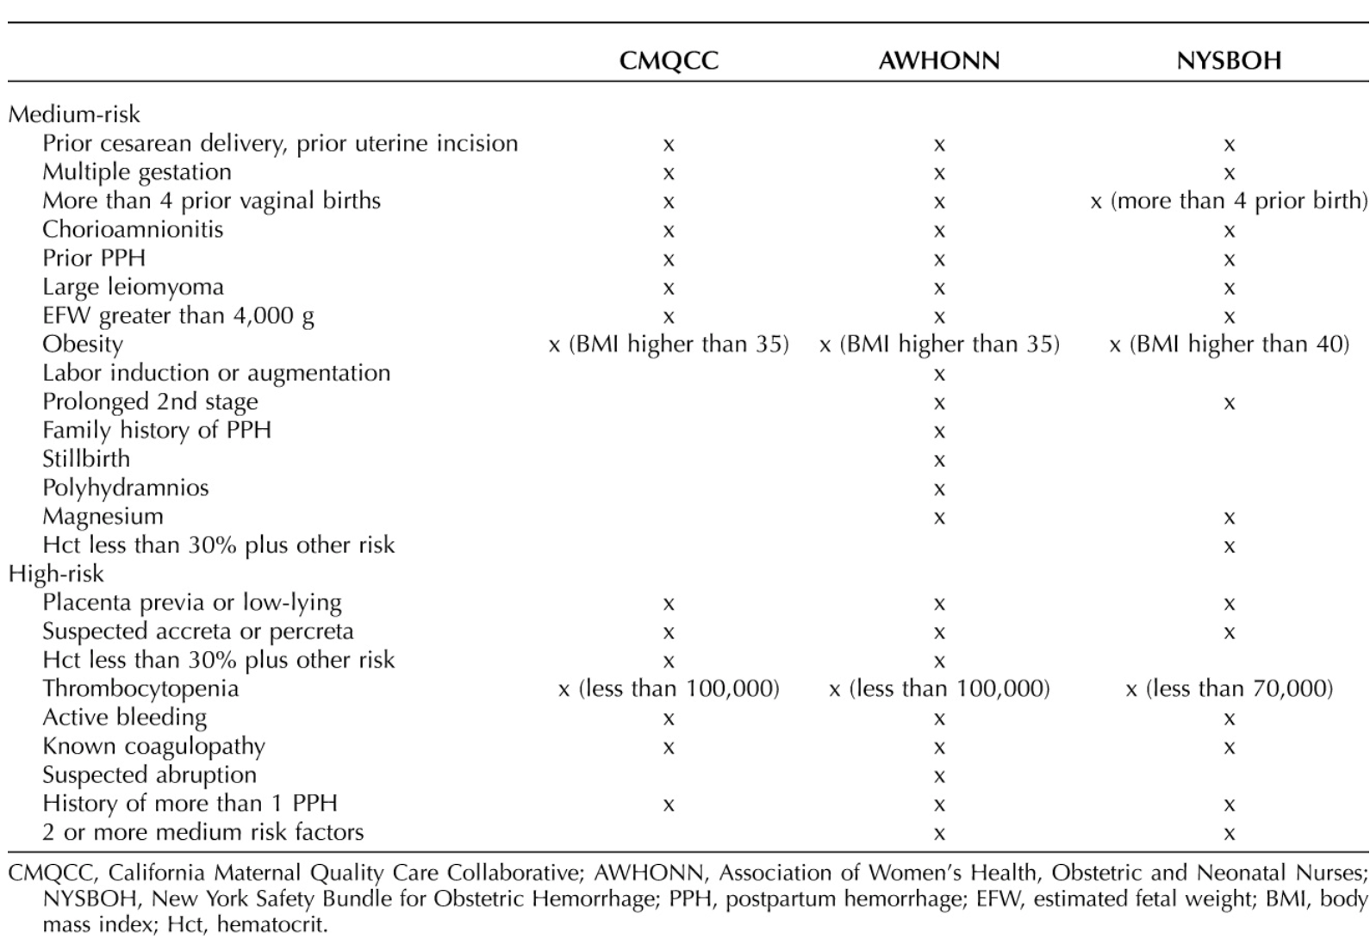
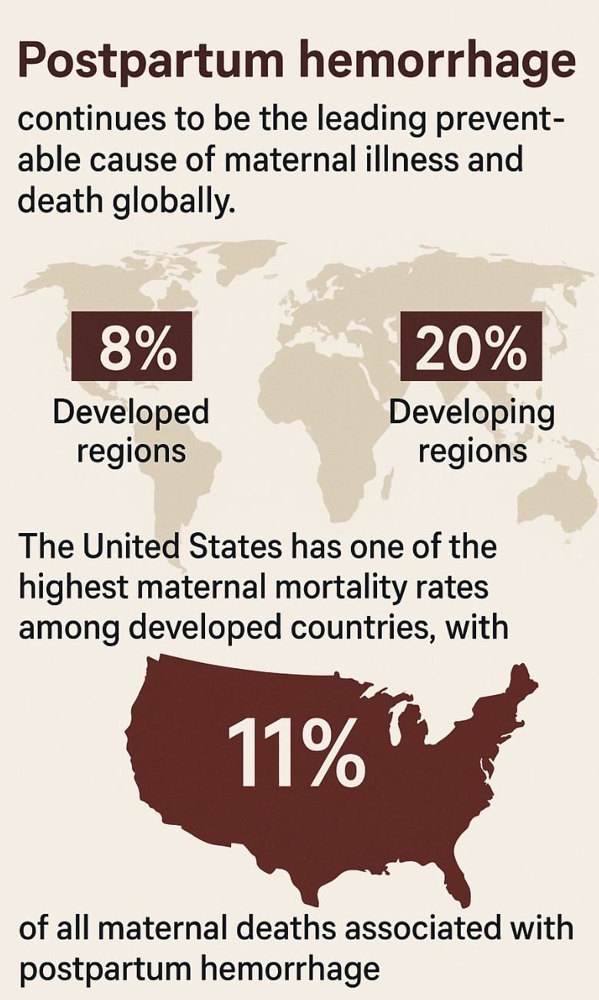
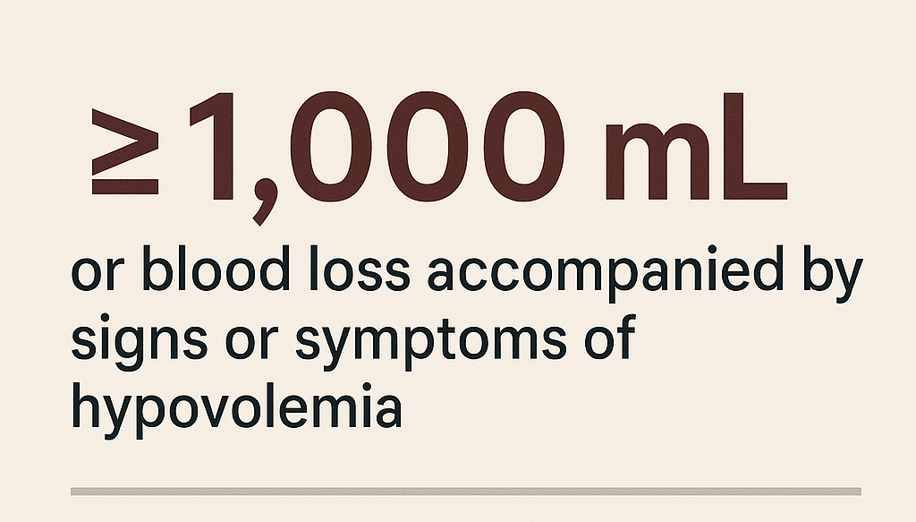

Background
Risk Factors and Development of a Prediction Model for Postpartum Hemorrhage in Cesarean Delivery Brittany Nicole Burton, MD Cristianna Vallera, MD Department of Anesthesiology & Perioperative Medicine Division of Obstetric Anesthesiology
What is the problem?
Why is it a problem?
What is it?
Bienstock JL, Eke AC, Hueppchen NA. Postpartum hemorrhage. N Engl J Med. 2021;384(17):1635-1645.
Kawakita T, Mokhtari N, Huang JC, Landy HJ. Evaluation of risk-assessment tools for severe postpartum hemorrhage in women undergoing cesarean delivery. Obstet Gynecol. 2019;134(6):1308-1316.

Slide 2
Study Design & Methods
The National Inpatient Sample (NIS) is the largest all-payer, inpatient health care database in the United States designed to produce national estimates for inpatient outcomes
We conducted a retrospective analysis for the years 2019 – 2020 of women of child-bearing age ( ≥ 18 – 40 years old)
The study population was defined with NIS data element “I10_DELIVERY”, which indicated the delivery of a newborn on the discharge record
The primary endpoint was PPH, defined as ≥ 1,000 mL blood loss for cesarean delivery
ICD-10-CM codes were used to query and extract relevant codes for procedures and diagnoses
Variables known to be clinically significant and associated with the outcomes in previous research were incorporated into the analysis

Slide 3
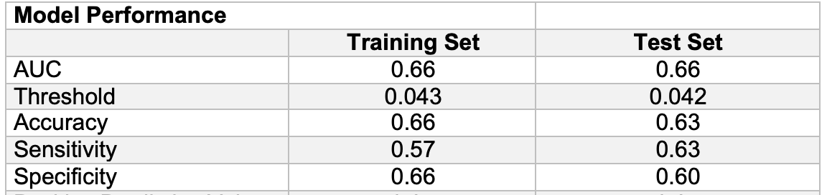
Results
The final study population included 429,354 individuals
The incidence of PPH among the study population was 4.4% (n = 19,094)
Race, age, income, insurance status, obesity, repeat cesarean, multiparity, iron deficiency anemia, leiomyoma, post-term pregnancy, HDP, eclampsia, placenta previa, placental abruption, preterm delivery, prolonged labor, chorioamnionitis, uterine overdistention, and coagulopathy were statistically significantly associated with PPH (all p<0.05).

Slide 4
Conclusion & Discussion
Current tools employ solely clinical factors into their algorithms and do not account for various demographic factors, specifically SDOH
There are unmeasured variables that influence the odds of PPH but not included in our model (beyond demographic factors included here)
Without accounting for these additional variables, the model's ability to predict PPH cases remains limited

