Slide 1
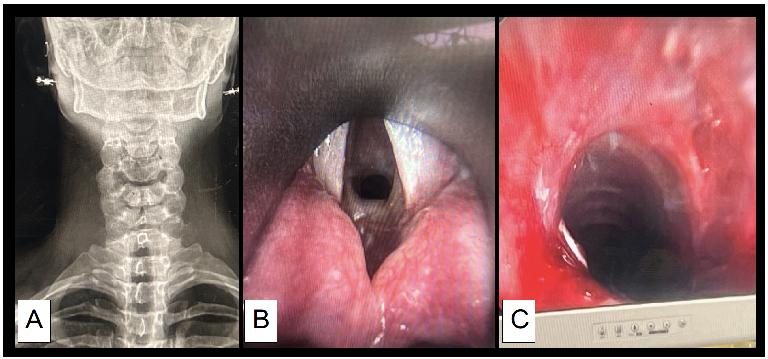
A Narrowing case of Subglottic Stenosis in Pregnancy: multidisciplinary approach for optimal maternal and fetal outcomes
Kalajian TA, Bowen R, and Hebbar L (Presenter: Nikke Bowerman, MD)
Background
Management
Take home points
Subglottic stenosis (SS) while rare can be life threatening and challenging to manage in pregnancy
Multidisciplinary approach includes obstetricians, otolaryngologists and anesthesiologists.
Most cases of SS in the literature report intervention during pregnancy with balloon dilation and/or CO2 laser with inherent risks of uteroplacental compromise and fetal hypoxia.
We report a case of SS treated with radial incision and balloon dilation immediately after cesarean delivery (CD).
Prioritized CD prior to airway intervention due to the risks of airway surgery during pregnancy
With ENT on standby, a healthy breech baby at 37 weeks was delivered uneventfully via CD under spinal anesthesia.
Patient’s neck was infiltrated with lidocaine by ENT for an emergency awake tracheostomy if needed.
Following CD and incision closure, general anesthesia was induced and maintained with propofol, rocuronium for relaxation and jet ventilation commenced.
Suspension laryngoscopy revealed the circumferential stenosis (B), which was successfully treated with Kenalog injection, sickle knife radial incisions and balloon dilation x 2 to 12 atm (C).
Patient tolerated the procedure well and emergence was uneventful.
This case highlights the challenges of managing SS in pregnancy, where airway obstruction and the need for surgery are complicated by maternal and fetal concerns.
Although difficult intubation rates are similar in pregnant and non-pregnant patients, the rate of failed intubations is higher in pregnant patients
Pregnancy-induced anatomical and physiological changes increase the risk of rapid desaturation with hypoxia due to reduced FRC and increased oxygen consumption.
Hormonal changes can cause upper airway edema, making intubation challenging.
Given these risks, delaying airway surgery if possible until after delivery is recommended.
While multidisciplinary approach is critical to the management of these cases, patients’ participation in the decision making is pivotal for optimal outcomes.
The Patient
29-year-old G1P0 at 36 weeks gestation
Recurrent subglottic stenosis of traumatic etiology
Worsening exertional dyspnea, biphasic stridor and chronic hoarseness. Admitted to antepartum service, and ENT consult obtained.
Chest X-rays: severe tracheal stenosis (A).
Nasopharyngeal fiberoptic revealed circumferential 80% SS with a roughly 2mm aperture of airway patency.

