Slide 1
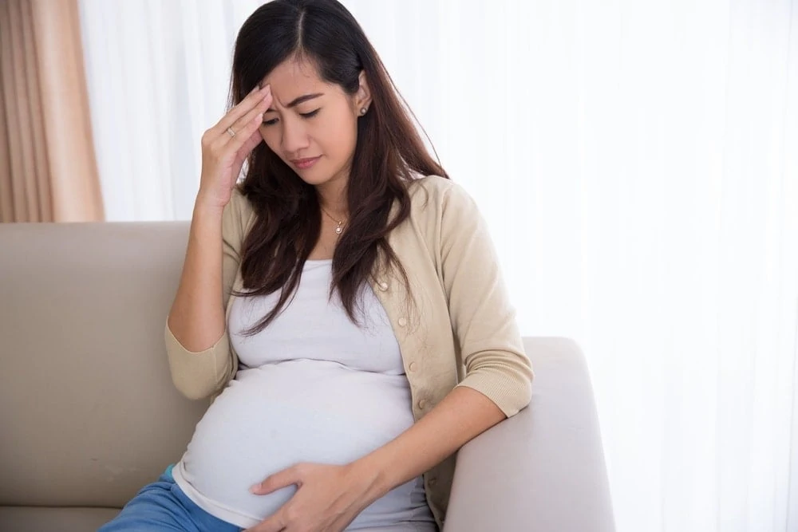
“Acute Ptosis, Headache, and Facial Neurologic Deficits in Labor: What Could it Be?”
Joseph Israeli MD ¹, Mohamad Ayoub MD ¹
¹New York University Langone Health Department of Anesthesiology, Perioperative Care, and Pain Medicine
SOAP 2025 Annual Meeting
Portland, Oregon
Background
To resize boxes, click twice on the white box and drag the bottom of the box up or down.
A wide differential exists in the parturient with new onset neurological deficits.
Baseline stroke risk is higher and increases up to six times in the setting of pre-eclampsia (1).
Other dangerous pathologies including vascular injury and epidural hematoma must also be ruled out.
Epidural analgesia can cause Horner syndrome, which is normally benign and may complicate diagnosis (4).
Incidence is estimated at 0.13% (2) and may increase to 4% with epidural top-ups for C-sections (3).
Top-ups may increase incidence due to low lying ganglia or subdural placement
Horner etiology: cephalad local anesthetic spread vs. inadvertent subdural placement (4).
Other diagnoses may be entertained after ruling out more morbid pathologies.
Bell palsy, myasthenia gravis, etc.
An epidural can be either cause or confounder in the case of new onset neurologic deficits.
Funding statement and/or corresponding author contact information goes here.

Slide 2
“Acute Ptosis, Headache, and Facial Neurologic Deficits in Labor: What Could it Be?”
Joseph Israeli MD ¹, Mohamad Ayoub MD ¹
¹New York University Langone Health Department of Anesthesiology, Perioperative Care, and Pain Medicine
SOAP 2025 Annual Meeting
Portland, Oregon
Case Report
To resize boxes, click twice on the white box and drag the bottom of the box up or down.
ID: 29F G2P0010 at 39 weeks pregnant presents for elective induction of labor.
PMH: hypothyroidism, gestational hypertension, traumatic brain injury, mild asthma
An epidural relieved her labor pain
Nine hours after the initial epidural and 30 minutes after a top off she developed neurological deficits
Right sided ptosis, right facial anesthesia, a 5/10 headache, and “seeing flashing lights and spots.”
PERRL but no observed miosis, no diplopia, no slurred speech, nor eyebrow sparing.
Headache characteristics:
Retroorbital, unilateral, and associated with nausea.
No photo/phonobia, neck stiffness, nor with positional worsening
Preeclampsia with severe features was diagnosed, and a stroke code was called (tPA was not given).
The CT of her head was normal.
Her epidural was restarted effectively
Delivery was uncomplicated and neurologic deficits resolved 3-4 hours after stopping the epidural.
Outpatient labs/imaging ruled out thoracic outlet syndrome or myasthenia gravis.
Funding statement and/or corresponding author contact information goes here.

Slide 3
“Acute Ptosis, Headache, and Facial Neurologic Deficits in Labor: What Could it Be?”
Joseph Israeli MD ¹, Mohamad Ayoub MD ¹
¹New York University Langone Health Department of Anesthesiology, Perioperative Care, and Pain Medicine
SOAP 2025 Annual Meeting
Portland, Oregon
Teaching Points
To resize boxes, click twice on the white box and drag the bottom of the box up or down.
Please see below for a differential diagnosis for new onset neurological deficits in the obstetric population
Pathology: | Facial Droop? | Eyebrow sparing? | Headache? | Other features?
Stroke | Often, unilateral | Yes | Sometimes | Slurred speech, extremity weakness
Lumbar epidural hematoma | Unlikely | N/A | Can be severe | Back pain, lower extremity deficits
Carotid Dissection | Often, unilateral | Yes | Often | Painful horner syndrome, perhaps no anhidrosis
Thoracic outlet | No | N/A | Sometimes | Typically unilateral, upper extremity fatigue, neurological deficits, swelling
Horner Syndrome | Eye only | N/A | Depends on cause | Ptosis and/or miosis and/or anhidrosis but incomplete presentation possible
Bell Palsy | Often, unilateral | No | Sometimes | Lower motor neuron facial nerve paralysis. Normally unilateral
Myasthenia Gravis | Yes, uni or bilateral | Typically yes | Sometimes | Ptosis, diplopia, fatigueable muscle weakness. Postsynaptic lesion
Oculomotor Nerve palsy | No | Yes | No | May be of ischemic, compressive, infiltrative, or traumatic etiology
References:
Miller EC, Leffert L. Stroke in Pregnancy: A Focused Update. Anesth Analg. 2020 Apr;130(4):1085-1096. doi: 10.1213/ANE.0000000000004203. PMID: 31124843; PMCID: PMC7035913.
Horner's syndrome following epidural analgesia during labor: report of six cases. Rabinovich A, Abedelhady R, Mazor M, Piura B, Margolin E. Eur J Obstet Gynecol Reprod Biol. 2010;149:229–230. doi: 10.1016/j.ejogrb.2009.11.020.
The incidence of Horner's syndrome during lumbar extradural for elective Caesarean section and provision of analgesia during labour. Clayton KC. https://associationofanaesthetists-publications.onlinelibrary.wiley.com/doi/abs/10.1111/j.1365-2044.1983.tb14074.x?sid=nlm%3Apubmed. Anaesthesia. 1983;38:583–585.
Chambers, D. (n.d.). Horner’s syndrome following obstetric neuraxial blockade - A systematic review of the literature. International journal of obstetric anesthesia. https://pubmed.ncbi.nlm.nih.gov/29657082/
“Headaches during Pregnancy.” American Pregnancy Association, 27 Apr. 2018, americanpregnancy.org/healthy-pregnancy/pregnancy-health-wellness/headaches-and-pregnancy/.
“Phosphenes (Seeing Stars) - All about Vision.” Allaboutvision.com, 2021, www.allaboutvision.com/conditions/symptoms/phosphenes/.
Funding statement and/or corresponding author contact information goes here.

