Slide 1
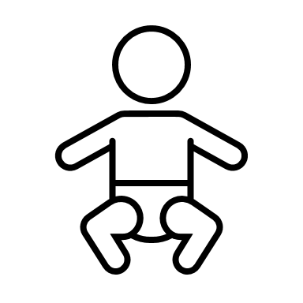
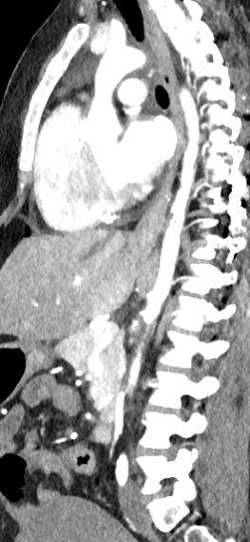
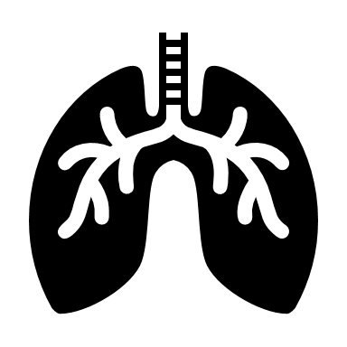
Management considerations for the obstetric patient with Takayasu's arteritis
Jasmine Kim, MD and Katelyn Scharf, MD
Introduction
Takayasu's arteritis (TAK) is a large vessel vasculitis that classically affects women of childbearing age. It affects the aorta and its branch arteries.
Clinical Case
31 year-old G2P0 at 30w6d with a history of TAK presenting with severe range blood pressure from clinic.
HOD 0
HOD 1: Delivery
Spinal: bupivacaine 7.5mg + fentanyl 15ug + morphine 150ug
Epidural: lidocaine 2% 5mL
HOD 1-4: ICU
Discussion
Vascular dissections and stenoses
Aortic regurgitation
Narrow blood pressure therapeutic window
Non invasive blood pressure measurement

