Slide 1
The TRPV4 channel could be part of the problem—and the solution—in uterine atony
Daiana D. Fornes, PhD; Guillermina Michel, BS; David N. Cornfield, MD;
Jessica R. Ansari, MD, MS
Stanford University School of Medicine

Slide 2
SPEAKER DISCLOSURE
I have nothing to disclose.
Notes:
I have nothing to disclose.

Slide 3
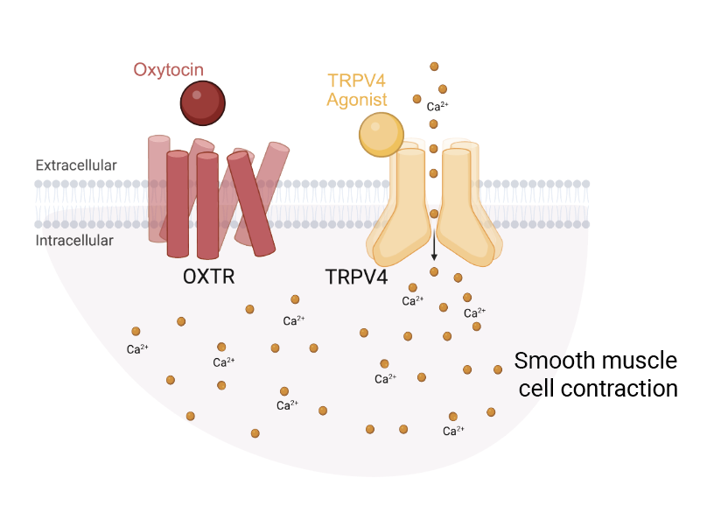
Clinical Problem & Knowledge Gap
Uterine atony
Oxytocin Treatment Gaps
Failure of the uterus to contract firmly after delivery to stop bleeding from the placental bed (~500ml/min)
Causes 80% of maternal hemorrhage cases
Impacts 1 in 12 deliveries
#1 cause of maternal death worldwide
Oxytocin is a first-line treatment for uterine atony
Mechanism of action (and failure in atony) remain incompletely understood
Hypotheses
TRPV4 is required for oxytocin effects
TRPV4 dysfunction contributes to uterine atony
Notes:
When the uterus fails to contract after delivery, a mother can lose 500 milliliters of blood per minute.
Uterine atony:
Causes 80% of maternal hemorrhage cases
Affects 1 in 12 deliveries
And remains the leading cause of maternal death worldwide.
Oxytocin remains our first-line treatment.
But sometimes... oxytocin fails.
And we still don’t fully understand why.
So we asked:
Could another player be involved — one that oxytocin depends on?
We focused on TRPV4 —
a mechanosensitive calcium channel.
Think of TRPV4 as a tiny gatekeeper:
when it is activated, TRPV4 opens, calcium rushes in — and contraction begins.
Our hypothesis was simple:
TRPV4 is required for oxytocin’s effects.
And TRPV4 dysfunction may contribute to uterine atony.

Slide 4
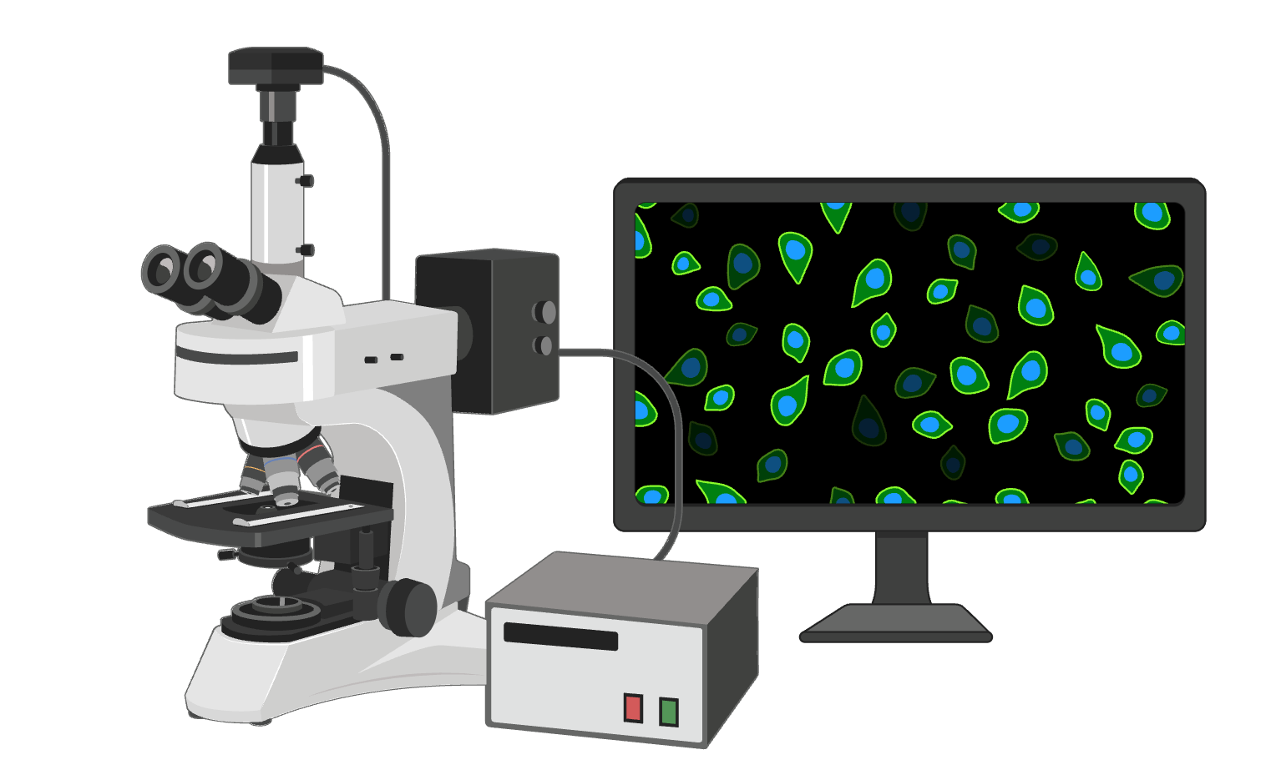
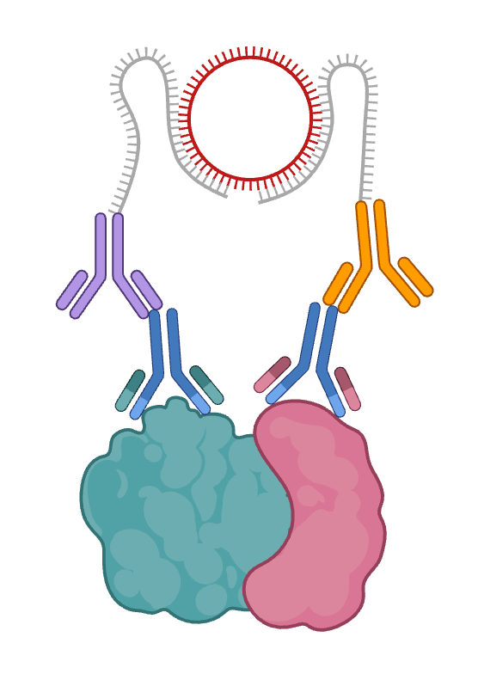
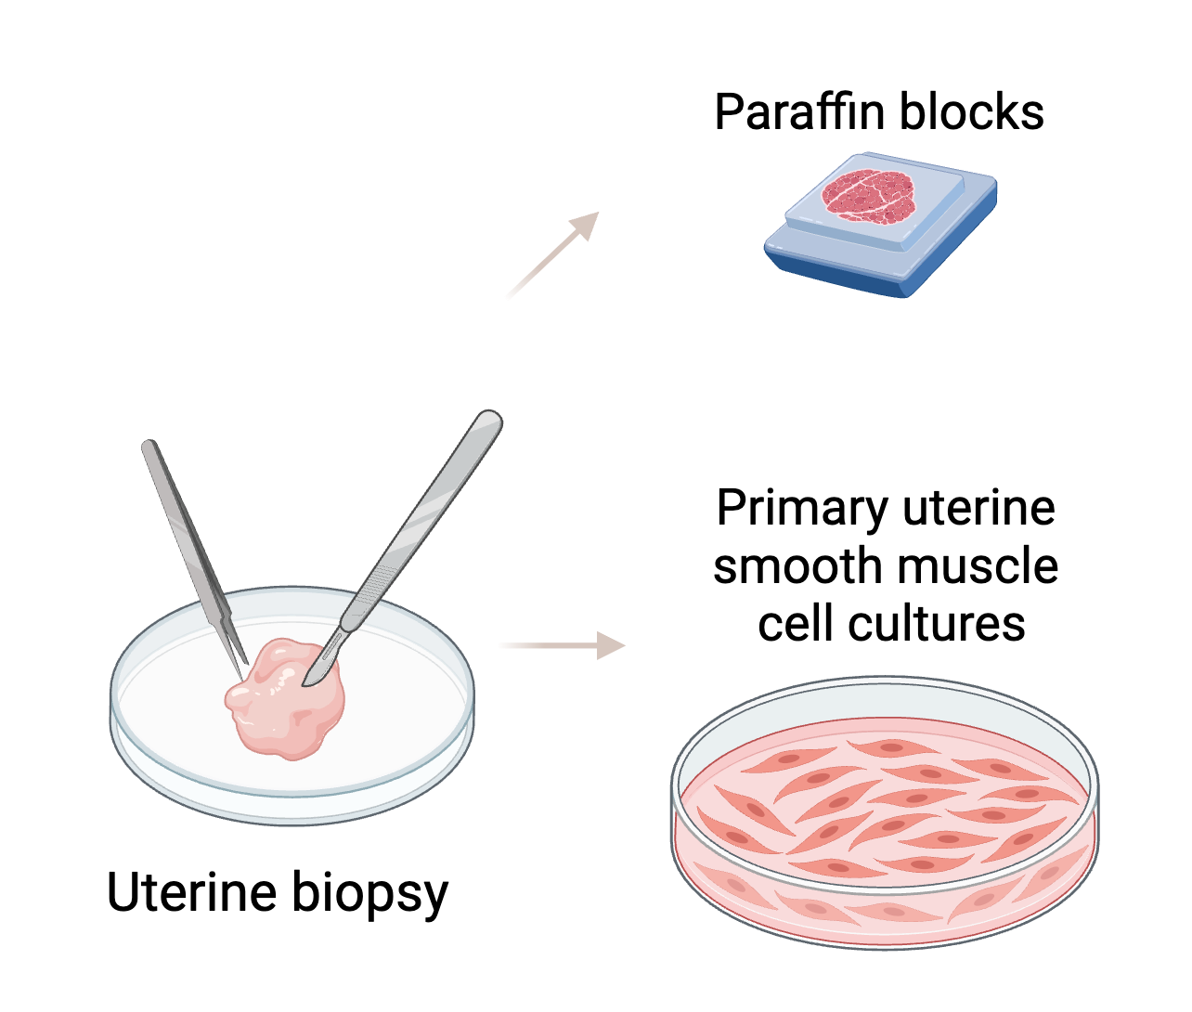
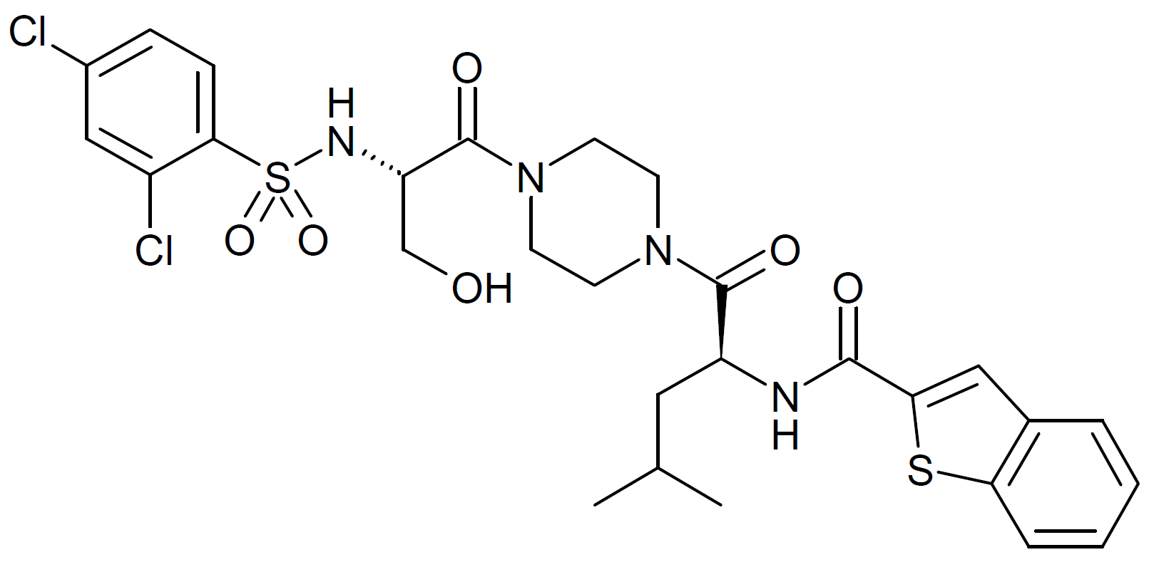
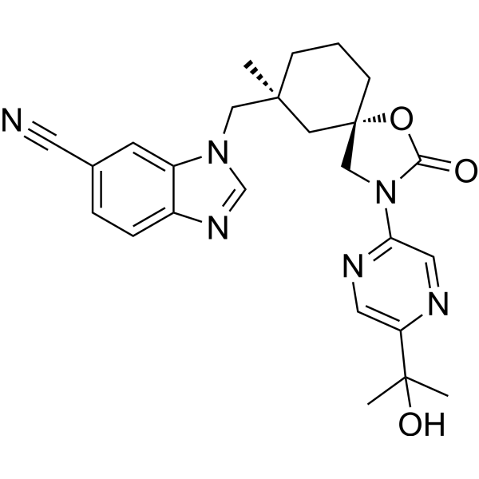
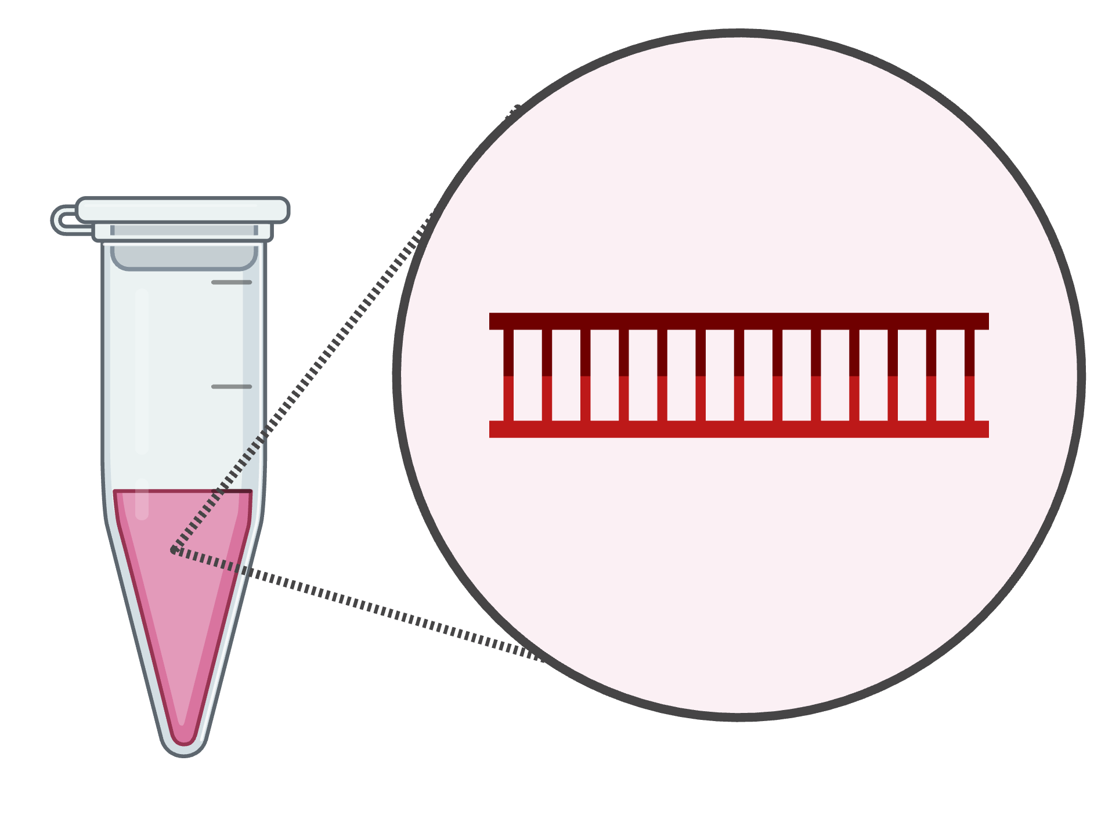
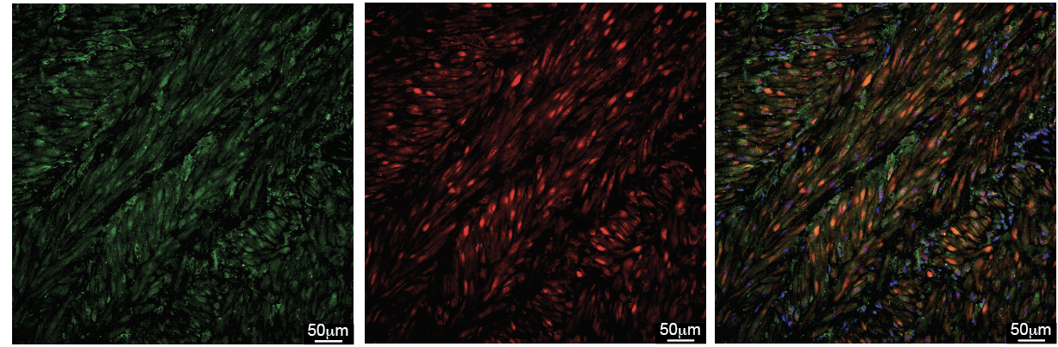
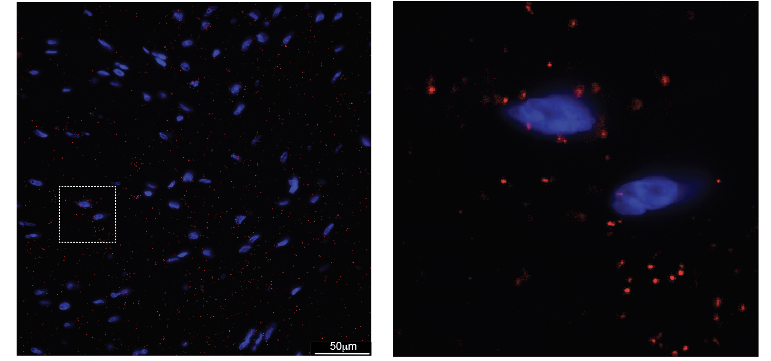
Methods
Human Myometrial Samples
Term, non-laboring cesarean deliveries (≥37 weeks)
Control
Uterine tone score ≥ 8
one dose oxytocin
QBL < 1000 mL
Assays
Calcium imaging
Collagen gel contraction
Proximity Ligation Assay (PLA)
Biopsies collected from the upper margin of the lower uterine segment incision, post-placenta delivery.
Atony
Uterine tone score < 6
2nd line uterotonic
QBL > 1000 mL
TRPV4 modulation
Pharmacologic agonist and antagonist
Genetic siRNA knockdown
Results: TRPV4 and OXTR interact in the gravid human myometrium
TRPV4 and OXTR colocalize in uterine smooth muscle
TRPV4 and OXTR interact in term myometrium (PLA)
TRPV4
OXTR
Nuclei/TRPV4/OXTR
Nuclei/TRPV4-OXTR
Notes:
So, how did we test it?
We collected biopsies from term, non-laboring cesarean deliveries — at 37 weeks or more — right after placenta delivery, from the upper margin of the lower uterine segment.
We defined two groups.
First we measured OXTR and TRPV4 protein expression by IF In the first panel, you can see TRPV4 expression in green; in the second, OXTR in red; and in the third panel, the merged image.
So we confirmed that both TRPV4 and the OXTR are expressed in human uterine smooth muscle at term.
Then we wondered: Are they just expressed in the same tissue… or do they actually interact?
To test this, we performed a PLA. The blue shows the nuclei, and the red puncta indicate that the two proteins — OXTR and TRPV4 — are very close, possibly even interacting.
And here, we clearly see a strong signal confirming that OXTR and TRPV4 do interact.
This was an exciting finding - because if OXTR interacts with TRPV4…
Are they working together?

Slide 5
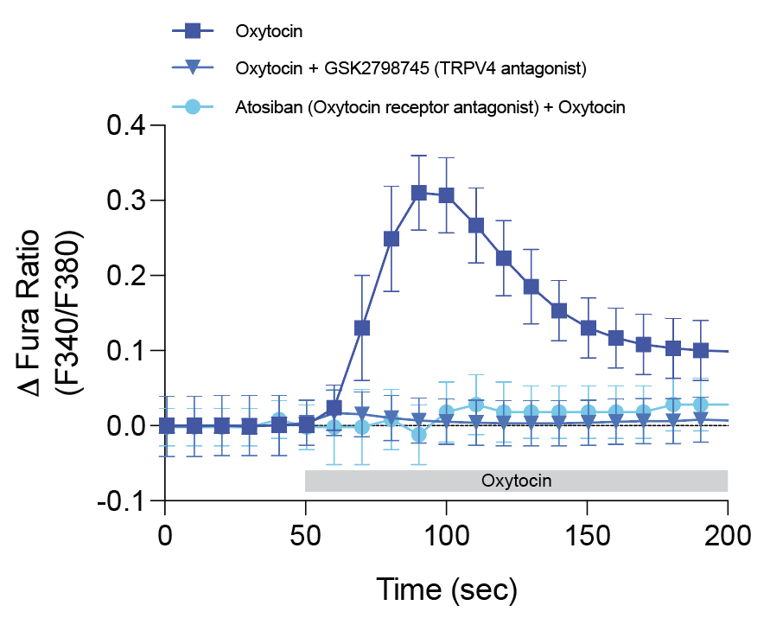
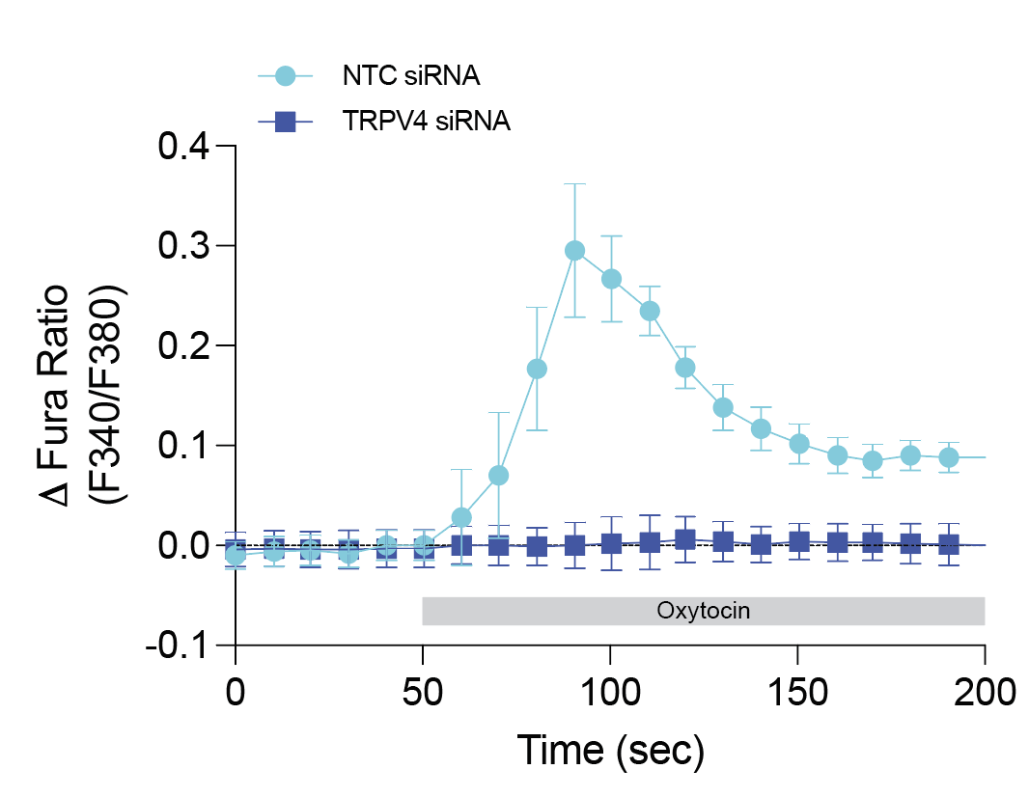
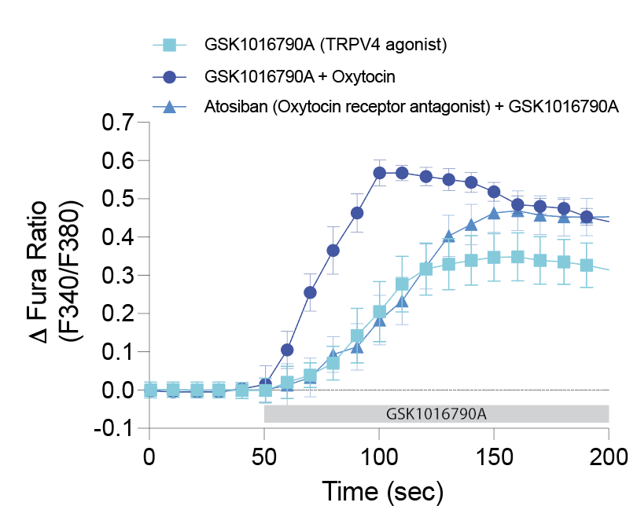
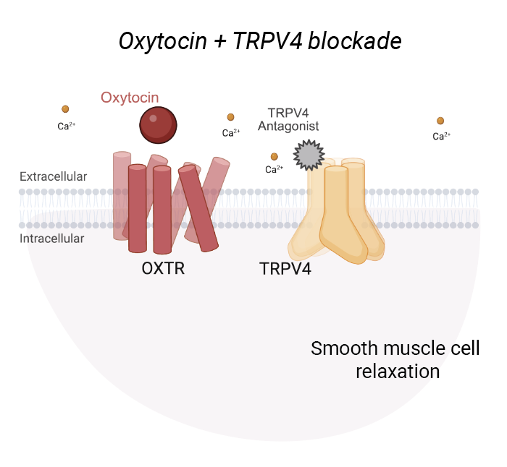
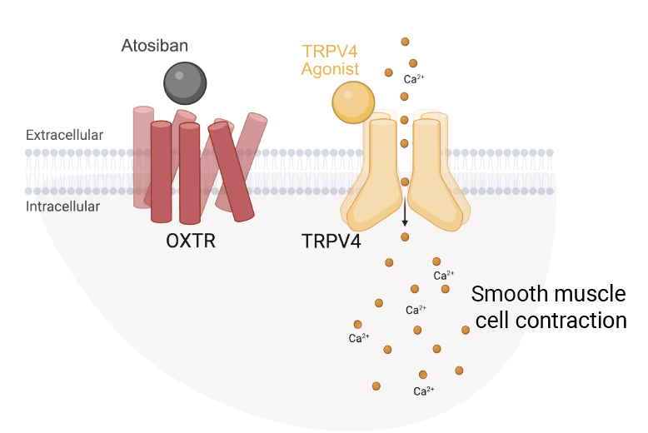
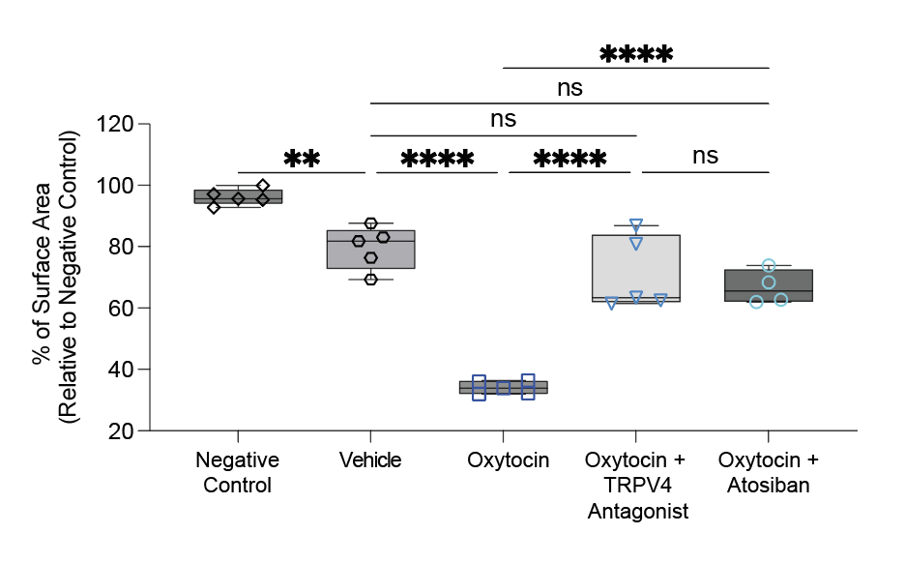
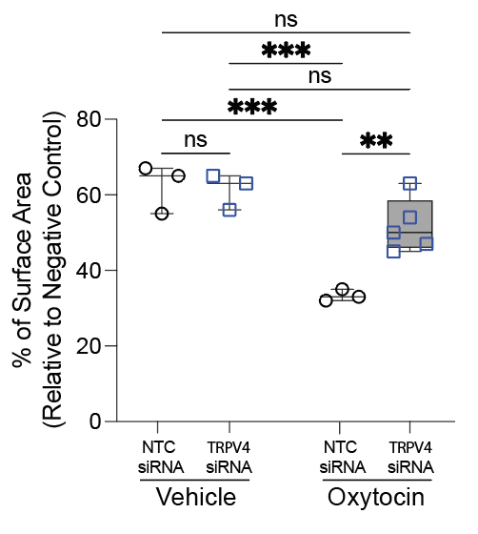
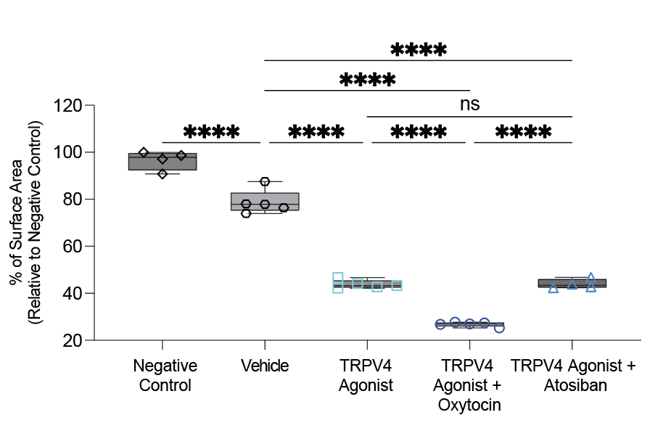
Results: TRPV4 is Required for Oxytocin Response
TRPV4 Inhibition
TRPV4 Activation
Oxytocin does not work when TRPV4 is blocked
TRPV4 does not need oxytocin to
cause contraction
Intracellular Calcium
Intracellular Calcium
Contraction Assay
Contraction Assay
Notes:
Our next move it was run functional experiments
We blocked TRPV4 — both with antagonists and siRNA — and then stimulated with oxytocin. The result? No calcium response. No contraction.
“Oxytocin does not work when TRPV4 is blocked”
Then we flipped the experiment: We blocked OXTR and activated TRPV4 directly.
Calcium still increased, and contraction still occurred. "TRPV4 does not need oxytocin to cause contraction."
Here, I’d like to highlight that this changes how we understand oxytocin signaling. In human myometrial smooth muscle cells, TRPV4 is required for oxytocin-induced Ca²⁺ signaling and contraction.

Slide 6
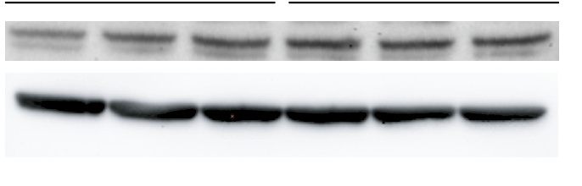
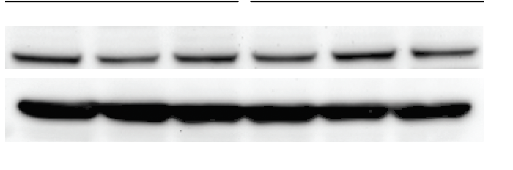
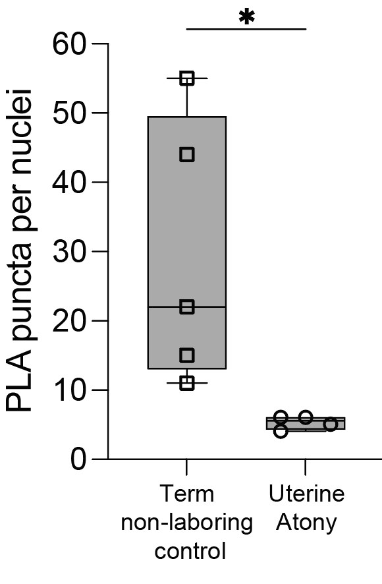
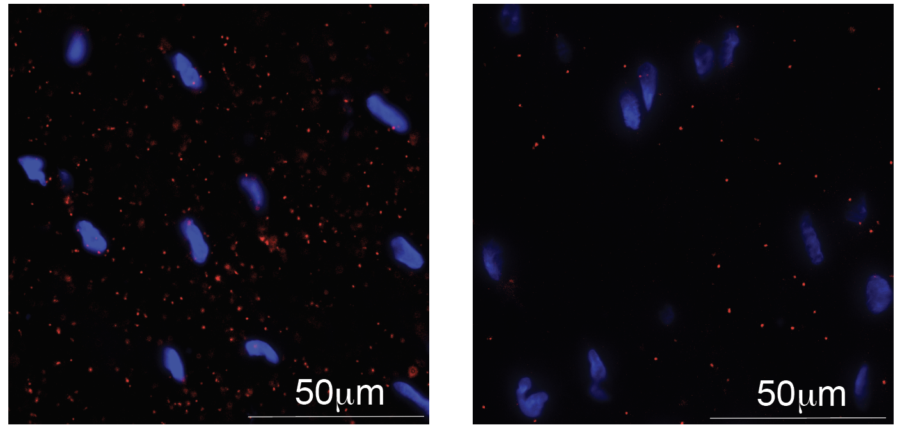
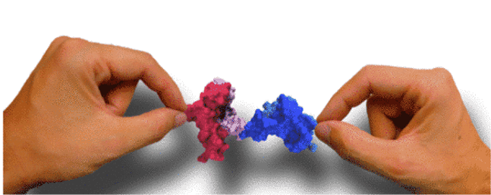
Results: In uterine atony TRPV4-OXTR interaction is reduced
OXTR protein expression
TRPV4 protein expression
Term non-laboring Control
Uterine Atony
Term non-laboring Control
Uterine Atony
Reduced TRPV4–OXTR interaction may cause uterine atony
OXTR
TRPV4
β-actin
β-actin
Term non-laboring Control
Uterine Atony
Nuclei/TRPV4-OXTR
Notes:
But we had one more question: Could this mechanism explain uterine atony?
We performed WB to study TRPV4 and OXTR protein.
We wondered if they were reduced. They weren’t — their expression was similar. And honestly, that was a bit disappointing.
So we thought — maybe the interaction itself is altered.
Voilà.
It was dramatically reduced.
The physical interaction between TRPV4 and OXTR was significantly reduced in uterine atony samples.

Slide 7
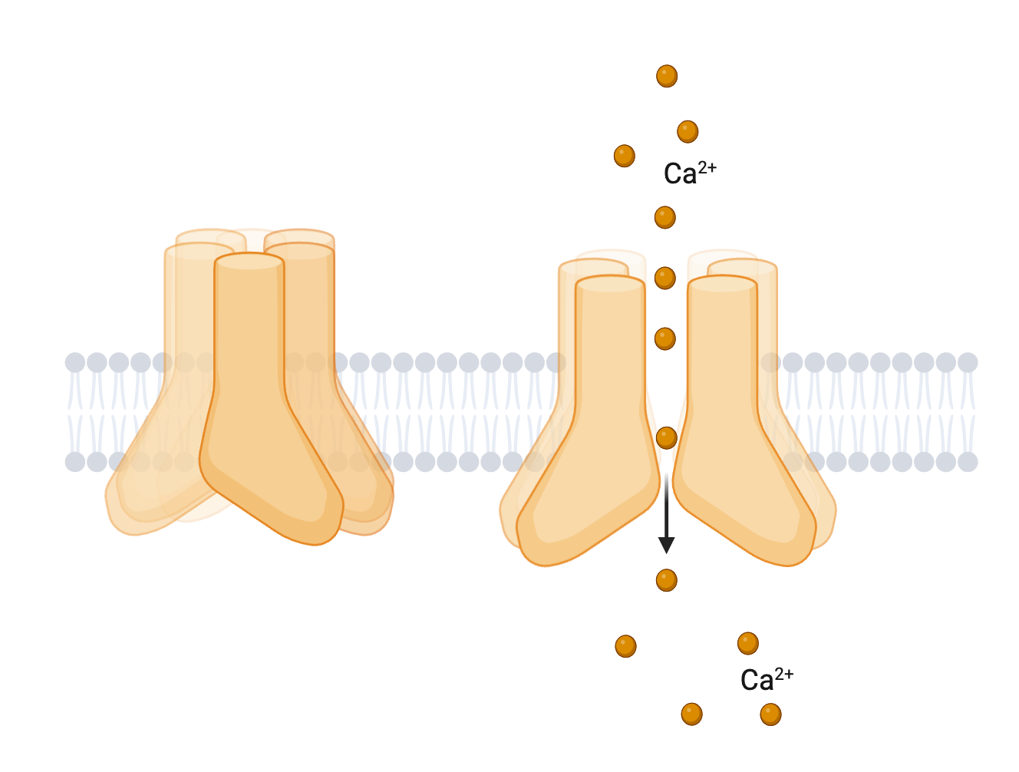
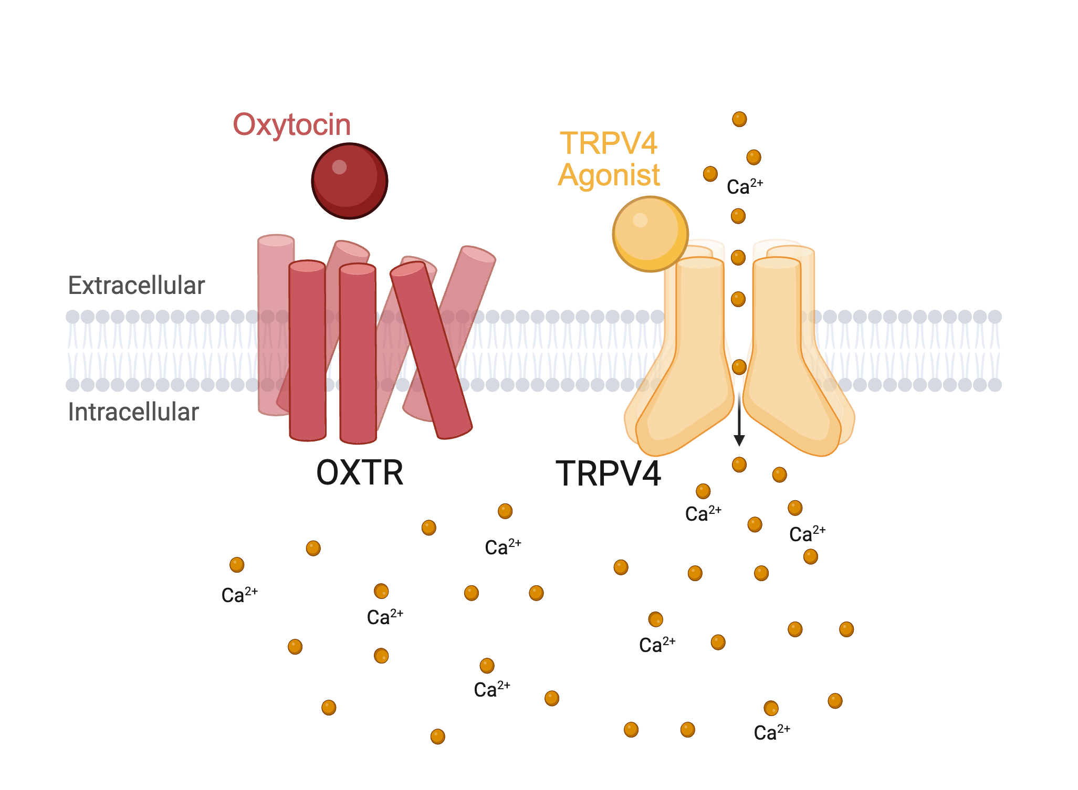
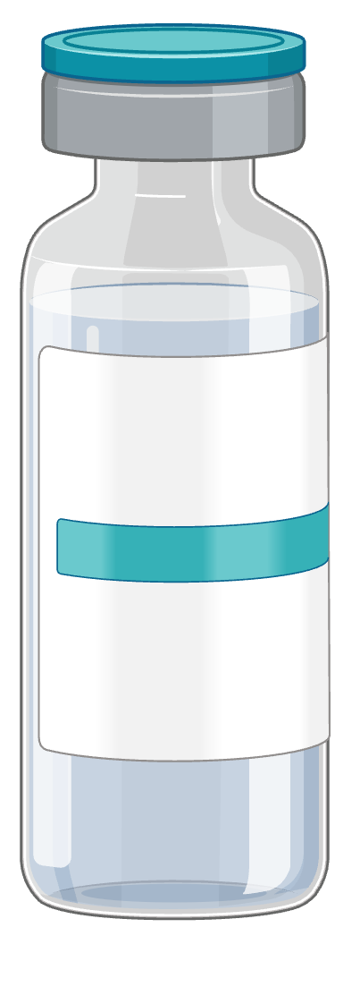
Summary & Future Directions
KEY FINDINGS
CLINICAL RELEVANCE
NEXT STEPS
TRPV4 is required for oxytocin-induced Ca²⁺ signaling and contraction
TRPV4–OXTR interaction is reduced in uterine atony
Reduced TRPV4- OXTR interaction could help explain why some patients do not respond to oxytocin.
TRPV4 could be a novel uterotonic target
Study how OXTR opens the TRPV4 channel
Explore whether restoring TRPV4–OXTR coupling can recue uterine atony
Long-term:
screen TRPV4-targeting compounds as uterotonics.
This work was supported by the Stanford Maternal & Child Health Research Institute
Notes:
TRPV4 is critical for oxytocin-induced contraction.
And a breakdown in TRPV4–OXTR interaction may underlie uterine atony.
By understanding this pathway, we may find new ways to treat postpartum hemorrhage —especially when oxytocin alone isn’t enough.
Thank you.

