Slide 1
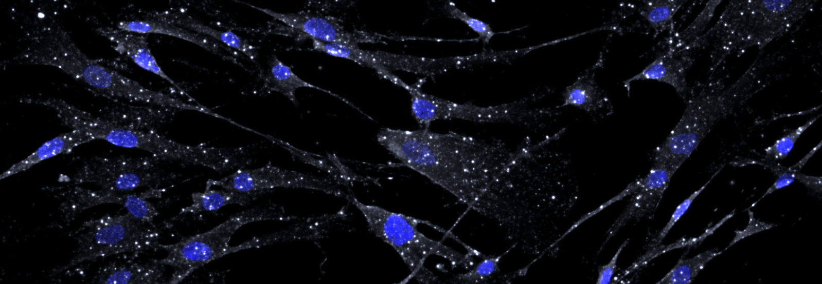



SINGLE NUCLEAR TRANSCRIPTOMICS UNCOVER DOWNREGULATION OF FSHR IN THE MYOMETRIUM OF PATIENTS WITH UTERINE ATONY
.
Jessica Ansari, Daiana Fornes, Carsten Knutsen, Guillermina Michel, Alexander Kum, Virginia Winn, David Cornfield

Slide 2
SPEAKER DISCLOSURE
Work funded by NIH, nothing else to disclose.
Notes:
I have no financial disclosures, this work was funded by the NIH.

Slide 3


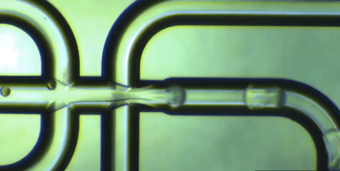

BACKGROUND
Uterine atony
Causes 80% of PPH
More than half of cases occur in low-risk patients
We need to figure out the why on a cellular and molecular level to:
  Predict (biomarkers)
  Treat (develop new uterotonics)
Single cell transcriptomics
Count all the RNA transcripts in each cell of a tissue sample
Can look at each different cell type for differences, for example between uterine atony and control patients
Notes:
My brilliant colleague Dr. Fornes already did my work for me here. Uterine atony is a huge problem, responsible for most cases of postpartum hemorrhage. And although we have some idea of why uterine atony occurs in some cases, for example patients with a giant stretched out uterus from triplets or a fatigued uterus from prolonged labor with chorioamnionitis….
More than half of cases happen in patients with no risk factors. And in those patients, we really don’t understand what is going wrong to make the uterus muscle not contract after delivery. And we need to know to be able to better predict those patients and ideally have them deliver in high risk centers with good resources. And we need to know to be able to develop new treatments for uterine atony.
Enter single cell transcriptomics. In single cell transcriptomics, we take all the cells in a sample, in this case a uterine biopsy, and we are able to count every single RNA transcript in every individual cell to generate a ginormous amount of information.
Now I don’t have a PhD, and I’m going to explain this with a metaphor that makes sense to me. Imagine that in optimal cases, when the uterus contracts like gangbusters after delivery, we have this nice coordinated phenomenon happening like a wave in a soccer stadium.
And in uterine atony we have this sad state of affairs. Poor guy.
Single cell transcriptomics is like having a microphone transcript on every single person in the stadium, and using computer software to figure out why the wave worked in several cases compared to why it didn’t in several others. This data may tell us that the dude was surrounded by fans from the other team. Or he was obnoxious and trying to self-initiate a wave over and over whereas the wave works when the announcer calls for it over the speaker. Or it all depends on the announcer and how motivating they are!
Just like this metaphor, we can go into our analysis with some hypotheses, but the data, much like microphone recordings, is unbiased and may show us something totally unexpected.

Slide 4
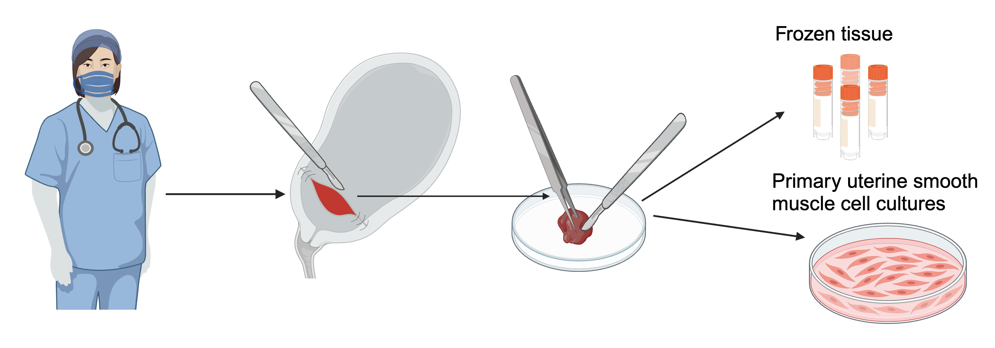
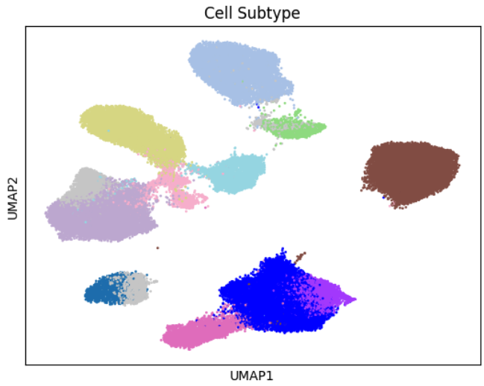
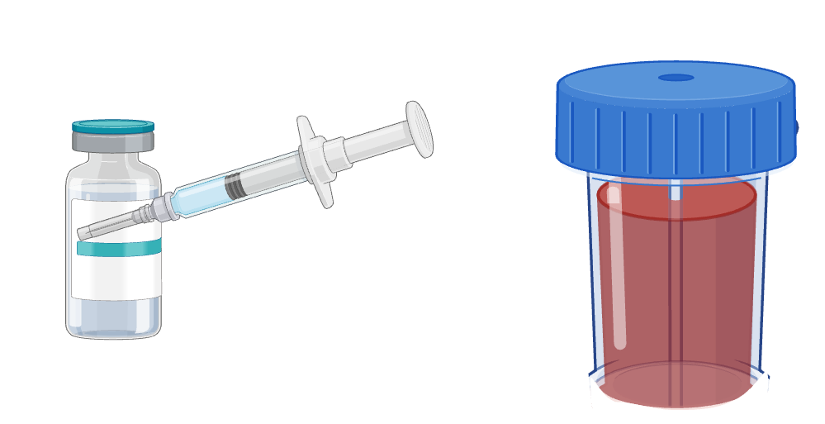
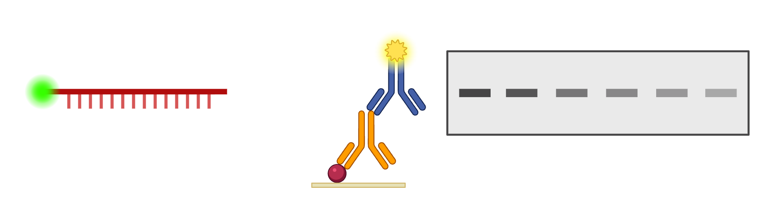
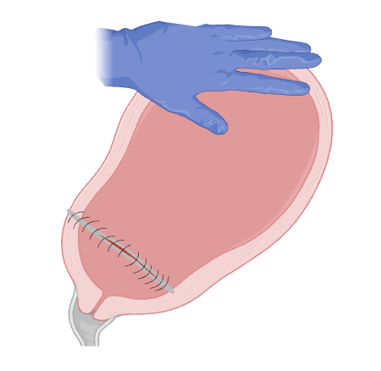
METHODS
Biobank of uterine tissue and cells
Step 1: What are the cell types?
Generate a single cell RNAseq atlas
(n=15) and validate cell types
Lower uterine segment biopsies n=170
Step 2: How do the RNA transcripts in the different cell types differ in uterine atony (n=4) compared to controls (n=4)?
Step 3: Validate: measure the RNA and protein of interest in uterine smooth muscle cells
RNA:
fluorescent in situ hybridization
Protein: immunofluorescence and Western blot
Atony: Uterine tone score < 6 + 2nd line uterotonic + QBL > 1000 mL
Control: Uterine tone score ≥ 8 + one dose oxytocin + QBL < 1000 mL
Notes:
How did we actually do this? For the past three years, we have been generating a biobank of uterine biopsies taken from the lower uterine segment from consenting patients. These are patients undergoing scheduled cesarean delivery, and we have frozen tissue and frozen smooth muscle cells in culture for each patient.
Before we could use single cell transcriptomics to try to understand uterine atony, we actually had to first generate an atlas and determine the cell types of the human uterus, because this technology had not yet been applied to pregnant uterine tissue! So we selected 15 samples from our database for this atlas.
Once we determined the cell types, we could look at differences in uterine atony in each cell type. For this part of the experiment, we compared 4 patients with uterine atony and no risk factors to 4 controls. We defined uterine atony as a uterine tone score on a 0-10 scale less than 6 plus a second-line uterotonic administration + a PPH with QBL>1000. Controls were matched on age, gestational age, race/ethnicity, BMI, and indication for delivery. They had a uterine tone score greater than or equal to 8, received only prophylactic oxytocin bolus, and did not have PPH.
And once we got some preliminary results from our single nuclear RNAseq, we used smooth muscle cells from the biobank to confirm RNA and protein expression for the genes of interest.

Slide 5
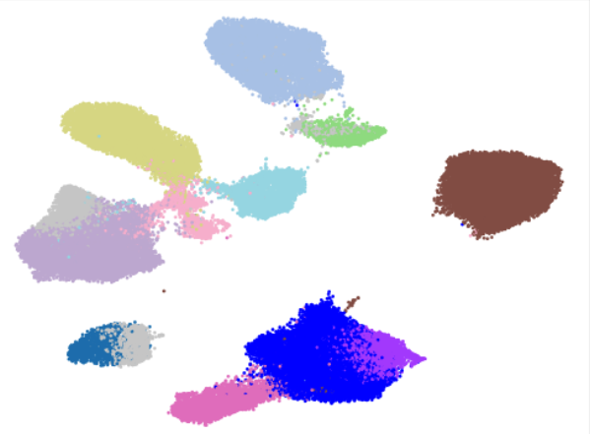
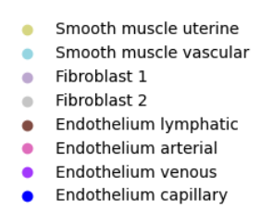
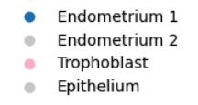

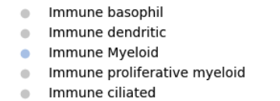
RESULTS STEP 1: single nuclear RNA seq atlas (n=15)
Notes:
So as I said, step one was to generate the first single nuclear RNA sequencing atlas of the pregnant human uterus. This was a huge computational effort, but at the end of the day we found 19 cell types including 2 smooth muscle cell types and a number of immune, endothelial, stromal, and even fetal cells. The heatmap at the bottom of the screen has genes on the x axis and cell types on the Y axis. The heatmap shows multiple genes unique to each cell type, where yellow shows high expression and purple no expression.
Importantly, we found two very distinct smooth muscle cell types. This hasn’t been shown before and is very important to studies in smooth muscle contractility like we do in our lab. And then we went back and validated these cell types in tissue using in situ hyvridization techniques.

Slide 6
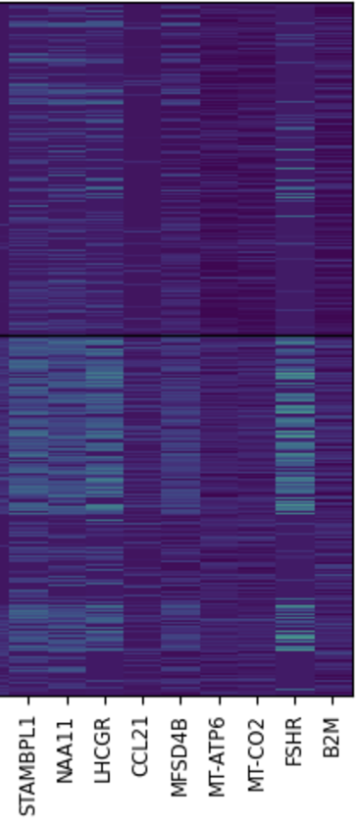
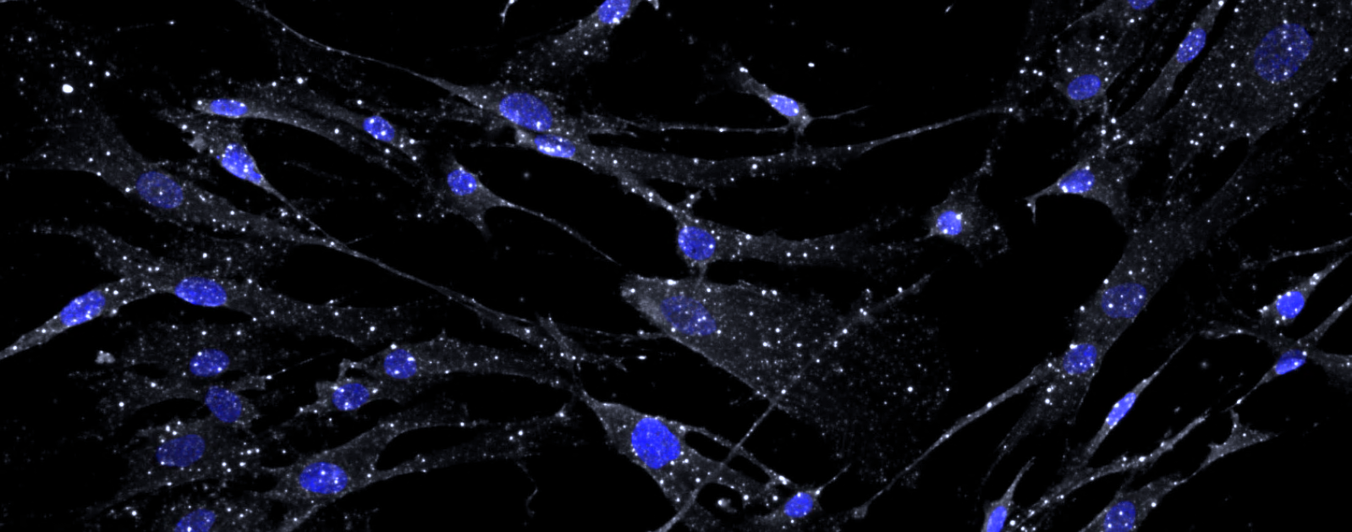
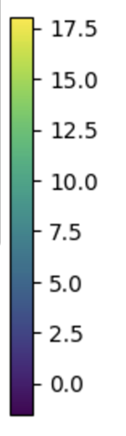


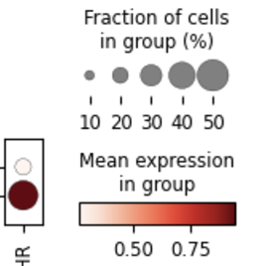
RESULTS STEP 2-3: Less FSHR in uSMC in uterine atony
Gonadotropin and reproductive endocrinology
signaling pathway genes in uterine smooth muscle cells
Validation: Do we actually have FSHR in our uterine smooth muscle cells?
Control
Uterine atony
RNA in situ hybridization: yes! N=6
FSHR
Transcript
copies/cell
β actin
FSHR in uterine
smooth muscle cells
Protein Western blot: yes! N=6
Uterine Atony (n=4)
Control (n=4)
Protein IF: yes! N=6
Notes:
Now for the exciting part. Once we had our atlas, we could start to ask the question: what is different specifically in the uterine smooth muscle cells from patients with uterine atony? One unexpected pattern that emerged in our analysis was that gonadotropin and REI-relevant signaling pathways were way down in our samples from patients with uterine atony.
As one specific gene, the follicle stimulating hormone recepter was virtually absent in all 4 samples from patients with uterine atony compared to controls.
This is cool but begs the question– is there such a thing as extragonadal FSH action? It turns out there is controversy, with one publication claiming it’s present, upregulated in pregnancy, and stimulates contraction and another publication claiming it isn’t there at all!
So we needed to validate. First, is FSHR RNA present in our smooth muscle cells in culture? The answer is a resounding yes! In this picture in the top right, the blue ovals are the nuclei of smooth muscle cells. And the white dots represent mRNA transcripts for the FSH receptor.
OK but then is the protein present? By immunofluorescence, it sure looks like it! And by Western blot we can quantify it. Again here nuclei are blue, and this time the FSHR protein is green.

Slide 7

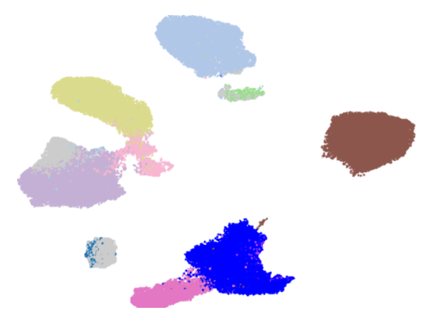
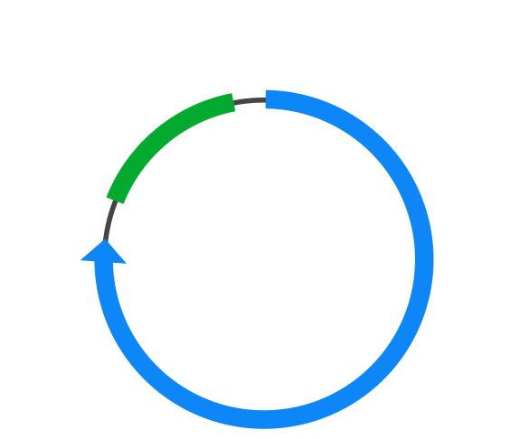
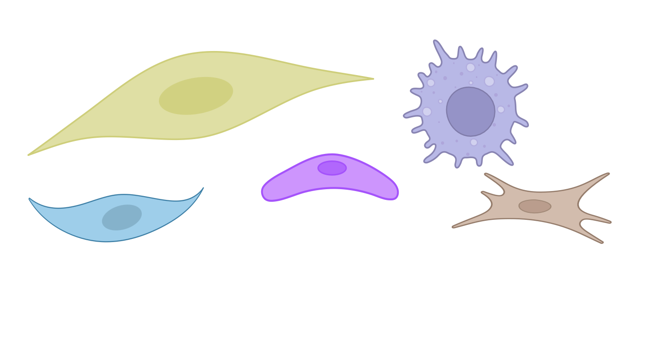
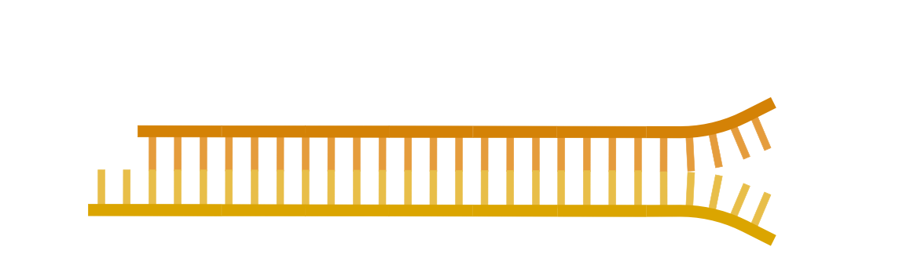
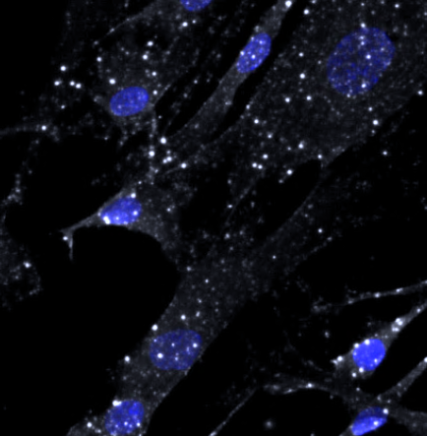

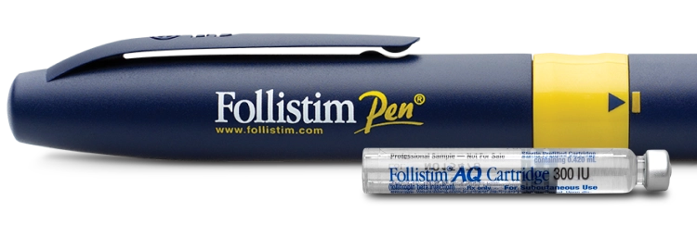
SUMMARY AND NEXT STEPS
WHAT WE DID
First snRNAseq of human gravid uterus tissue
Validate the different cell types
Smooth muscle cells from patients with uterine atony have lower FSHR
WHY IT MATTERS
New insights about cell types and uterine atony
Resolves a controversy in the field (extragonadal FSH receptors are present!)
May lead to new ways of predicting and treating uterine atony
WHAT’s NEXT
Overexpress FSHR. Does contractility improve in response to oxytocin or FSH?
Silence FSHR. Does contractility worsen in response to oxytocin or FSH?
Uterine atony
DOWN THE LINE…
Control
A uterotonic?
Notes:
So we generated the first single nuclear RNAseq atlas of the gravid human uterus, validated the cell types, and were able to use it to get a totally new hypothesis about what could be causing uterine atony.
Not only does this resolve a controversy in the literature, but down the line it could lead to new prediction and treatment!
What’s next:
Down the line:

