Slide 1
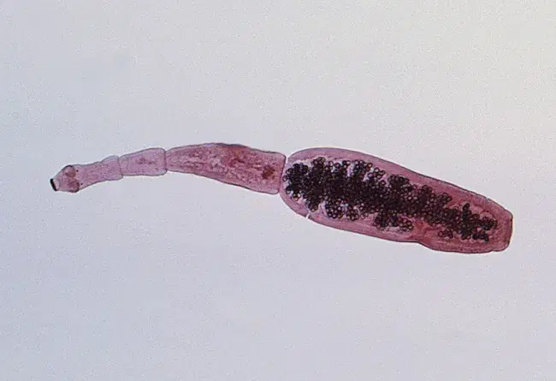
Comorbid Hydatid Cysts and VWD Type 2b in Pregnancy
Lauren Nguyen, Sherry Liou MD MBA, John Markley MD PhD, Maytinee Lilaonitkul MD, Ben Li MD, Pamela Huang MD
Background:
Echinococcus granulosus → Hydatid cysts (e.g. in the liver)
Parasitic cestode found in regions w/ livestock-rearing, rare in the US
Cyst rupture can cause anaphylaxis and death
Von Willebrand disease (VWD) type 2b = ↑ binding of VWF to platelets → ↑ Clearance of VWF/platelet complexes → Thrombocytopenia
Pregnancy induces greater release of abnormal VWF → Risk of hemorrhage
Specific guidelines for VWD type 2b not established
No other known case of both coexisting in pregnancy
Images: https://www.webpathology.com/images/infectious-disease https://www.cdc.gov/dpdx/echinococcosis/index.html

Slide 2
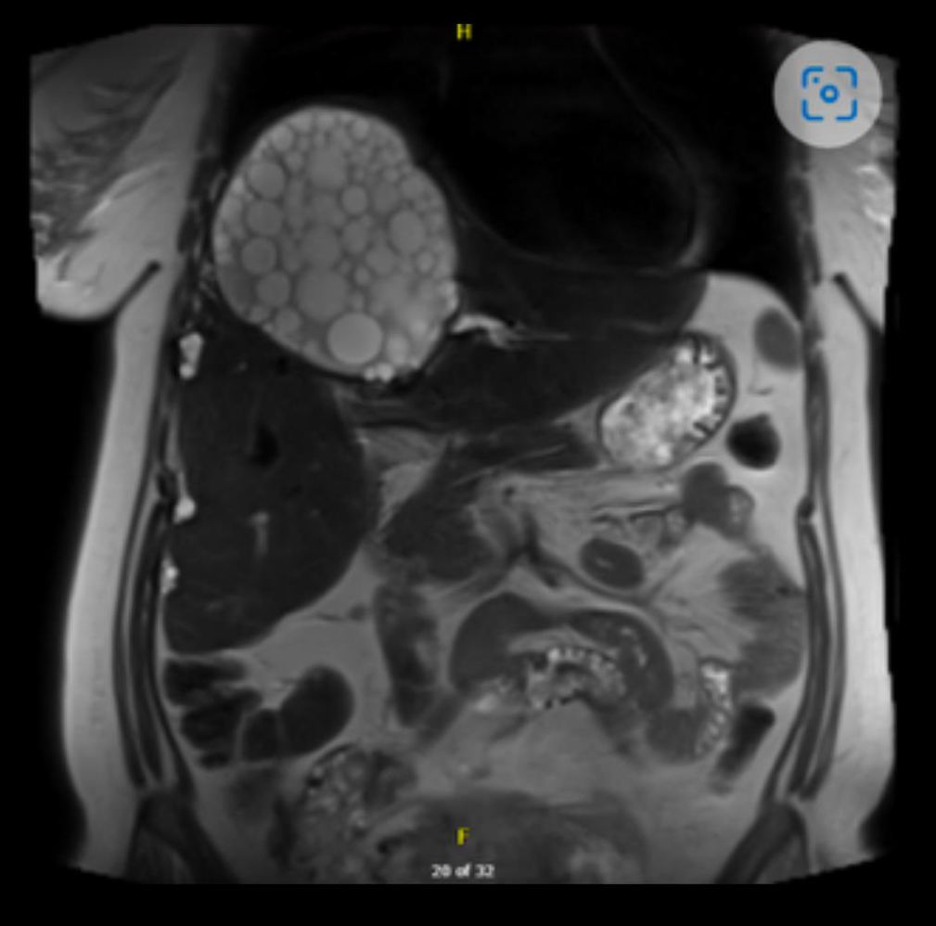
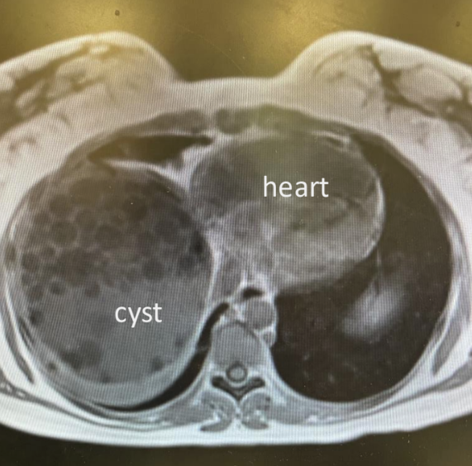
Comorbid Hydatid Cysts and VWD Type 2b in Pregnancy
~5w gestation: RUQ pain, nausea, vomiting
Imaging showed new cyst + daughter cysts in R hepatic lobe. Pt declined intervention
Peripartum monitoring:
Cyst stable by ultrasound
Platelets declined to 27,000 uL
Intraop plan: Vaginal birth in OR with multidisciplinary team, IV remifentanil PCA, <30 min laboring down
Remi 20-30 mcg w/ 2 min lockout interval
Pre-delivery Humate P + platelet transfusions
3 large bore IVs, aline and belmont ready
Trauma/Gen surg on standby
Delivery: Pushed 8 min, delivery uneventful, EBL 400ml. Pt stable & discharged on PPD3
39 yo woman
G6P5005
Refugee from Yemen, sheep herder
#VWD Type 2b excessive bleeding w/ prior procedures & pregnancies
#Echinococcal cyst 15x12x15cm previously drained, now reaccumulated
Notes:
Notably, last pregnancy 16 years ago

Slide 3
Comorbid Hydatid Cysts and VWD Type 2b in Pregnancy
1. Risk of bleeding & thrombocytopenia → Caution neuraxial anesthesia & refrain from desmopressin → Remifentanil PCA & humate P & platelet transfusions
2. Fetus may have VWD → Avoid forceps/vacuum delivery (↑ ICH)
Anesthetic Considerations:
VWD Type 2b
Echinococcal hepatic cysts
1. Monitor cysts over course of pregnancy
2. Risk cyst rupture and anaphylaxis → Avoid C-section, limit pushing, trauma/gen surg ready for emergent exlap if rupture
Overall: interdisciplinary planning and adaptability led to successful trial and vaginal birth w/ OBGYN, MFM, anesthesia, hepatobiliary, hematology, trauma/gen surg, pediatrics & ID
References:
BMJ 2012;344:e3866
Blood. 2009;113(3):526-534
Blood. 2013;122(16): 2893–2902.
Blood Rev. 2020;39:100633.

