Slide 1
Anesthetic Management of Paroxysmal Supraventricular Tachycardia and Thromboembolic Risk in a Pregnant Patient with Complex Congenital Heart Disease
Lauren Nguyen, Jaber Hanhan, Jeremy Juang, Pedram Aleshi
Background:
Congenitally corrected transposition of the great arteries (CCTGA) frequently results in arrhythmias with most patients not surviving beyond 50 years
Pregnant patients with CCTGA are at increased risk for cardiovascular complications and fetal loss
There is limited guidance on managing SVT in pts with structural heart conditions like CCTGA, especially while pregnant

Slide 2
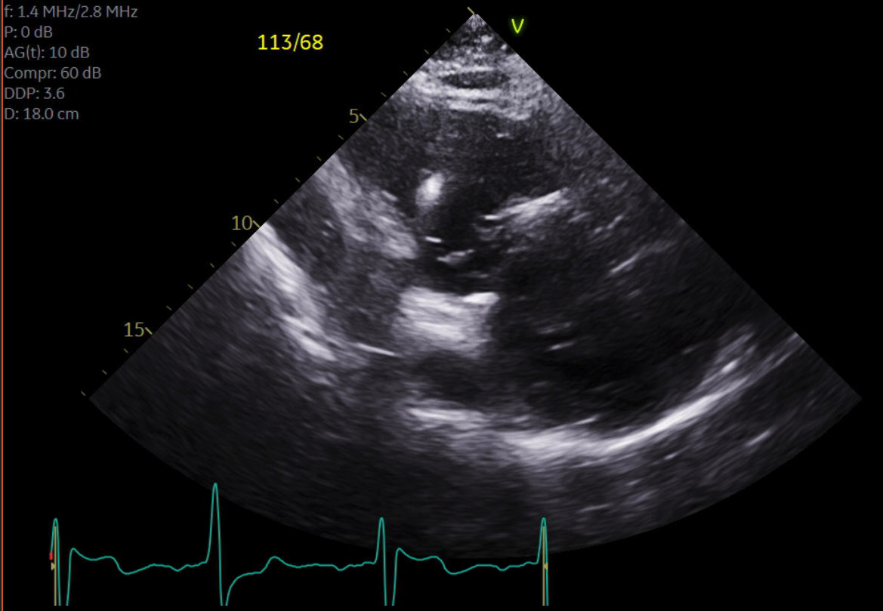
Anesthetic Management of Paroxysmal Supraventricular Tachycardia and Thromboembolic Risk in a Pregnant Patient with Complex Congenital Heart Disease
Lauren Nguyen, Jaber Hanhan, Jeremy Juang, Pedram Aleshi
33 y/o primigravid with L-transposition of the great arteries, pulmonary atresia + childhood cardiac surgeries
29+6 wks w/ asymptomatic SVT. Initial tx with pindolol, adenosine, and metoprolol unsuccessful
TTE: EF of 25-30%, normal R ventricle, and small mobile thrombus in L atrium → gave heparin → normal sinus rhythm. Pt discharged on sotalol & enoxaparin
Multidisciplinary team: Elective delivery at 37 wks w/ repeat TTE, hold LMWH 12 hrs prior d/t risk of bleeding w/ epidural
36+5wks: Fetus breech, ECV attempted. Dural puncture epidural chosen in case fetal decels warranted conversion to C-section. 10 mL 3% chloroprocaine + phenylephrine drip to prevent hypotension
Thrombus found in functional RA but anatomical LA
ECV unsuccessful but fetus stable. During C-section, +5 mL chloroprocaine added to achieve T4 level. C-section uneventful; pt discharged on PPD5.

Slide 3
Anesthetic Management of Paroxysmal Supraventricular Tachycardia and Thromboembolic Risk in a Pregnant Patient with Complex Congenital Heart Disease
Lauren Nguyen, Jaber Hanhan, Jeremy Juang, Pedram Aleshi
Conclusions:
Anesthetic considerations for pregnant pts w/ complex congenital heart disease, esp in regard to arrythmia + thromboembolic risk
When initially working up SVT, cardioversion contraindicated d/t thromboembolic risk (TTE revealed thrombus in L atrium)
At delivery, code cart was ready in case of instability
Dural puncture epidural chosen bc of ECV with potential conversion to C-section; LMWH heparin held 12 hours prior
Multidisciplinary approach w/ cardiology, MFM, and anesthesia + ICU-equipped facilities critical for ensuring safety of both mom and fetus
References:
J Clin Anesth. 2001;13(7):517-520.
J Am Coll Cardiol. 1999;33(6):1692-1695.
Thorac Dis. 2020;12(3):1213-1218.
Heart. 1998;79(6):622-623.

