Slide 1
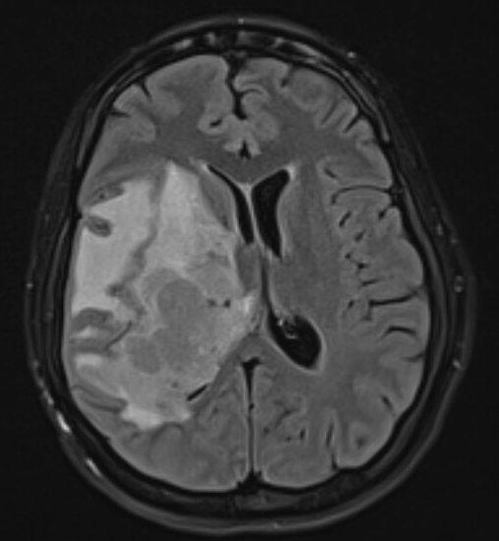
SOAP 2025 ANNUAL MEETING
Ethical and Anesthetic Considerations of a Parturient who Presents with Interval Progression of Glioblastoma and Midline Shift
Nikke Bowerman MD, Joel Sirianni MD, Jennifer Matos MD
Background:
Increased intracranial pressure (ICP) can be a challenge for delivery and anesthetic planning in a parturient approaching labor as valsalva maneuvers and neuraxial anesthesia are generally contraindicated
A 24-year-old G5P3013 presented at 34 weeks for repeat c-section in the setting of grade IV parietal diffuse hemispheric glioblastoma with significant interval progression over the month prior from 2.4 x 1.5 cm to 5.4 x 3.7 cm, vasogenic edema and 7 mm midline shift
Through much of this patient’s pregnancy, systemic therapy was held and subsequently there was significant increase in left hemiparesis and tumor growth over the month before delivery
She was ultimately given a <6 months life expectancy and emphasized to palliative care that quality of life was not her goal, but rather spending maximal time with her children before her imminent death.
Figure 1. Brain MRI 4 days prior to delivery

Slide 2
SOAP 2025 ANNUAL MEETING
Ethical and Anesthetic Considerations of a Parturient who Presents with Interval Progression of Glioblastoma and Midline Shift
Case Events:
Balancing fetal and parturient health, a plan was made for c-section at 35 weeks. However, given new onset polyhydramnios secondary to high dose dexamethasone treatments, delivery at 34 weeks was decided. The fetus was diagnosed with gastroschisis and severe fetal growth restriction
The patient underwent an uncomplicated c-section with general anesthesia with a pre-induction arterial line and rapid sequence intubation. Anesthesia was maintained by TIVA with propofol, and she was hyperventilated with EtCO2 30-35 mmHg.
Pain control consisted of pre-emergence bilateral quadratus lumborum nerve blocks, hydromorphone and ketorolac.
MRI post op day 1 showed slightly increased size and mass effect, increased midline shift increased to 10 mm with slightly increased left uncal herniation. Neurosurgery was reluctant to palliatively resect given tumor location and neuro-oncology discussed resuming therapy for tumor control rather than cure but was cautious to resume <4 weeks after c-section as therapy could compromise wound healing.

Slide 3
SOAP 2025 ANNUAL MEETING
Ethical and Anesthetic Considerations of a Parturient who Presents with Interval Progression of Glioblastoma and Midline Shift
Learning Points:
Neuroanesthesia considerations are critical to consider in a parturient with brain tumor and mass effect to avoid increases in ICP and brain herniation
In this case, delivery was planned at 35 weeks with c-section (to avoid active labor and Valsalva) under general anesthesia and propofol TIVA (to maintain tight etCO2 and decrease cerebral oxygen demand and PONV) with arterial line in place for tight hemodynamic control
Interdisciplinary communication and coordination is necessary to balance both the mother’s goals and optimize the neonate’s health (NICU, Peds Surgery, MFM, Neurosurgery, Neuro-Oncology and Palliative Care)
There were several ethical factors that made large impacts in the course of this patient’s story that required transparent communication between several multidisciplinary teams and an informed patient include pausing vs continuing systemic therapy during pregnancy, timing of delivery, anesthetic choice during delivery, goals of care, and risks/benefits of systemic therapy after delivery

