Slide 1
Comparison of Dexamethasone vs Ondansetron as the First-Line Antiemetic to Prevent Postoperative Nausea and Vomiting after Cesarean Delivery – A Double-Blinded Randomized Controlled Trial
Maria D. Patrocinio, MD
Amnon A. Berger, MD, PhD
Samantha L. Armstrong, BS
Maria C. Borrelli, DO
Yunping Li, MD
Philip E. Hess, MD
May 2nd, 2025

Slide 2
Background
Intra- and post-operative nausea and vomiting are common in cesarean deliveries. ¹
Ondansetron (OND) and dexamethasone (DEX) are effective in decreasing PONV.^{2,3}
Untreated Nausea & Vomiting
Intraop | Nausea | 44%
 | Vomiting | 21%
Postop | Nausea | 38%
 | Vomiting | 26%
PONV Reduction
 | Relative Risk | 95%CI
OND | 0.47 | 0.3 to 0.7
DEX | 0.68 | 0.5 to 0.9

Slide 3
Hypothesis
Robust Enhanced Recovery After Cesarean (ERAC).
Gap in knowledge for optimal first-line antiemetic.⁴
Ondansetron (OND) and dexamethasone (DEX) similar efficacy.
Dexamethasone reduces postoperative pain and opioid consumption.^{5,6}
Hypothesis: Postoperative global recovery improved with DEX as first line agent

Slide 4
Methods
Prospective randomized double-blind
5 mL syringe of either:
8 mg DEX
4 mg OND
Consent
Randomization
VAS at 2 h
Scheduled cesarean (CD)
Arrival
Pre-operative
Intraoperative
PACU arrival
PACU stay
Postpartum
Spinal anesthesia
11.25 mg Bupivacaine
25 mcg Fentanyl
150 mcg morphine
Visual Analog scale (VAS) for nausea, pain, and pruritus
VAS at 24 h
ObsQoR 11 score
Primary outcome:
Composite treatment (nausea, vomiting, pain, or pruritus) in the first 24 h

Slide 5
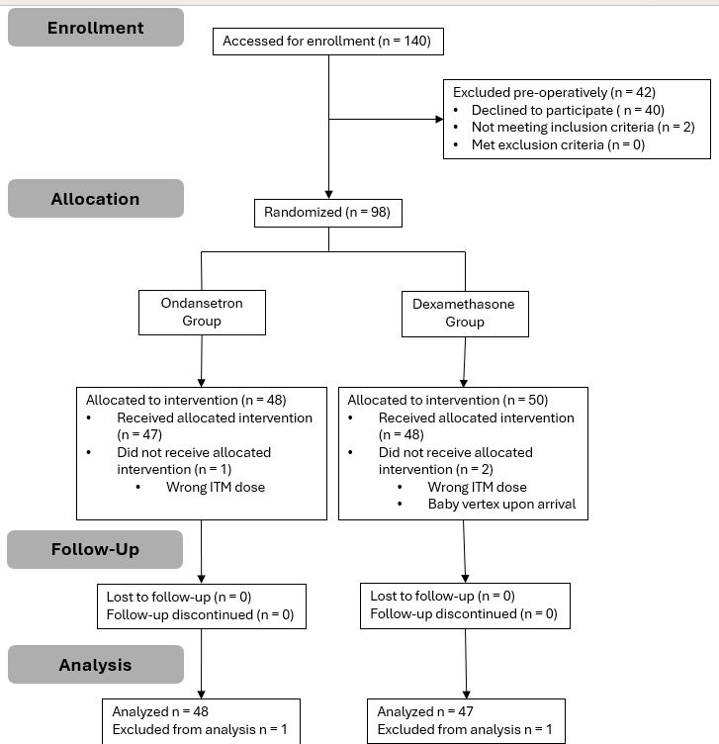
Results
Characteristic | Ondansetron n=48 | Dexamethasone n=47 | P-value
Age (y) | 34.5±4.3 | 36.3±3.5 | 0.01
Height (in) | 63.8±2.4 | 64.9±2.8 | 0.04
Weight (lbs) | 171.5±26.0 | 178.1±26.9 | 0.23
BMI | 29.5±3.8 | 29.6±3.9 | 0.90
Gestational age (weeks+days) | 39 [38+2d to 39+2d] | 39+1d [39 to 39+2d] | 0.33
Nulliparous | 15 (31.3) | 10 (21.3) | 0.35
Race |  |  | 0.9
White | 36 (75.0) | 38 (80.9)
Black | 3 (6.3) | 3 (6.4)
Asian | 6 (12.5) | 3 (6.4)
Other | 3 (6.3) | 3 (6.4)
Ethnicity |  |  | 0.01
Hispanic | 7 (14.6) | 0
Non-Hispanic | 41 (85.4) | 47 (100)
Education |  |  | 0.02
High school or less | 9 (18.8) | 0
Some college | 3 (6.3) | 3 (6.4)
College degree | 16 (33.3) | 13 (27.7)
Post-graduate | 19 (39.6) | 29 (61.7)
Not specified | 1 (2.1) | 2 (4.3)
Primary cesarean | 16 (33.3) | 14 (29.8) | 0.83
Surgical duration (min) | 91.0±23.3 | 85.2±19.1 | 0.14
Neonatal weight (kg) | 3.2 [2.9 to 3.6] | 3.6 [3.4 to 3.8] | 0.001
QBL | 435 [275 to 700] | 500 [286 to 639] | 0.89
Uterine exteriorized | 42 (87.5) | 34 (72.3) | 0.08
IONV | 11 (22.9) | 18 (38.3) | 0.12
Age (y) | 34.5±4.3 | 36.3±3.5 | 0.01
Height (in) | 63.8±2.4 | 64.9±2.8 | 0.04
Hispanic | 7 (14.6) | 0
High school or less | 9 (18.8) | 0
Post-graduate | 19 (39.6) | 29 (61.7)
Neonatal weight (kg) | 3.2 [2.9 to 3.6] | 3.6 [3.4 to 3.8] | 0.001

Slide 6
Results
 | # Meds | Mean | Median
OND | 2 | 0.23 ± 0.4 | 0
DEX | 4 | 0.4 ± 0.7 | 0
Outcome | OND n=48 | DEX n=47 | P-value
Pain 0 h | 0.22 ± 0.7 | 0.19 ± 0.7 | 0.32
2 h | 1.31 ± 1.5 | 0.92 ± 1.3 | 0.19
24 h | 3.11 ± 1.9 | 2.92 ± 2.0 | 0.59
Nausea 0 h | 0.53 ± 1.1 | 0.81 ± 1.3 | 0.14
2 h | 0.74 ± 1.3 | 0.69 ± 1.3 | 0.69
24 h | 0.12 ± 0.3 | 0.01 ± 0.03 | 0.16
Pruritus 0 h | 2.7 ± 2.2 | 1.9 ± 2.1 | 0.05
2 h | 2.8 ± 2.0 | 2.2 ± 1.9 | 0.13
24 h | 1.4 ± 1.8 | 1.8 ± 2.0 | 0.57
Pain/PONV/Pruritus treatment (P=0.96)
ObsQoR11 | OND n=48 | DEX n=47 | P-value
Total | 85.9±17.7 | 88.0±20.1 | 0.61

Slide 7
Discussion
OND and DEX have equivalent efficacy for IONV and PONV prophylaxis.
DEX immediate postoperative pruritus – exploratory.
Robust ERAC reduces pain & side effect scores.
Very low rates of side effects / pain – do we need either?

Slide 8
Thank you
References
PMID: 10422935
PMID: 33177330
PMID: 34002866
PMID: 24991614
PMID: 31058317
PMID: 38091865

