Slide 1
Medicaid Expansion, Medicaid Generosity, and Severe Maternal Morbidity During Delivery Hospitalizations
Jean Guglielminotti & Guohua Li

Slide 2
The Affordable Care Act Medicaid Expansion
Gave states the option to expand Medicaid coverage to low-income adults with incomes up to 138% of the Federal Poverty Level
FY 2025: Annual income ≤ $21,597 for a single person
Start of the state implementation: January 2014
PERINATAL PERIOD → INCREASED INSURANCE COVERAGE, HEALTHCARE ACCESS, AND HEALTHCARE UTILIZATION
e.g., ↑ number of prenatal visits in expansion states
MATERNAL HEALTH OUTCOMES → CONFLICTING RESULTS
e.g., ↓or → severe maternal morbidity in expansion states
Provision of continuous perinatal health insurance coverage to access care
Is a suggested policy to mitigate the US maternal health crisis

Slide 3
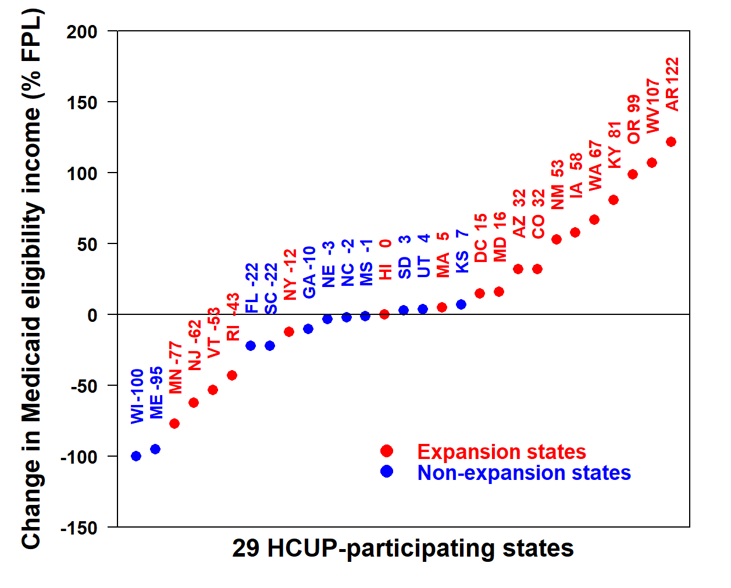
Limitation of Previous Research on Medicaid Expansion and Maternal Health Outcomes
Did not account for the variations across states in the change in the Medicaid eligibility income associated with the expansion (i.e., generosity)
Generosity → Absolute difference in Medicaid eligibility income between 2015 and 2013
Median in expansion states = +24% (range: -77, + 122)
Median in non-expansion states = -3% (range: -100, +7)

Slide 4
Aims
AIM 1: To assess the change in SMM rate associated with the expansion in expansion states compared to non-expansion states
Difference-in-differences method (2-way interaction), adjusted for patient, hospital, and state characteristics
SMM rate as defined by the CDC (exclusion of blood transfusion only)
HCUP data from 29 states from 2010 to 2018 (18 expansion and 11 non-expansion)
15 million delivery hospitalizations
AIM 2: To assess whether the change in SMM rate associated with the expansion depends on whether people live in a generous or non generous states
Adjusted difference-in-differences-in-differences method (3-way interaction)
Generous state: Change in Medicaid eligibility income > 0% FPL

Slide 5
Difference-in-Differences Method
Regression coefficient β3 of the 2-way interaction term
Logit (Y_{i}) = β0 + β1 Exposure_{i} + β2 Intervention_{i} + β3 Exposure x Intervention_{i}
Percent change = 100 x (e^{β3} -1)

Slide 6
Results: Difference-in-Differences Method
ALL STATES
Adjusted percent change
+4.7% (95% CI: 1.8, 7.6)

Slide 7
NON-GENEROUS STATES
Adjusted percent change
+8.8% (95% CI: 5.1, 12.6)
GENEROUS STATES
Adjusted percent change
-8.9% (95% CI:-15.4, -1.8)
Difference-in-differences-in-differences method
-15.1% (95% CI: 7.9, 21.8) adjusted relative decrease
in SMM rate in generous states compared to non-generous states

Slide 8
Subgroup Analyses for the Comparison of Generous and Non-generous States
No information on household income in HCUP data
→ Analyses of subgroups of people likely to be low-income
 | DIDD adjusted percent change (95% CI)
Quartile of ZIP code median household income
Quartile 1 (poorest neighborhood) | -28.5% (-39.3, -15.5)
Quartile 2 | -23.2% (-34.4, -10.1)
Quartile 3 | -10.7% (-23.5, 4.3)
Quartile 4 (richest neighborhood) | 14.2% (-6.3, 39.2)
Health insurance
Medicaid | -25.6% (-34.8, -15.1)
Private | -5.4% (-15.7, 6.0)

Slide 9
Conclusions
The impact of Medicaid expansion on maternal health outcomes depends on the state Medicaid generosity
State efforts to improve the health of low-income birthing people could focus on policies increasing Medicaid generosity

Slide 10
Acknowledgements
Department of Anesthesiology
- Richard Smiley
- Ruth Landau
- Guohua Li
Barbara Lang
Matthew Russell
Tricia Brentjens & Ansgar Brambrink
Department of Obstetrics and Gynecology
Alexander Friedman
Catherine Monk
Mailman School of Public Health
- Goleen Samari (Population and Family Health)
- Jamie Daw (Health Policy and Management)

