Slide 1
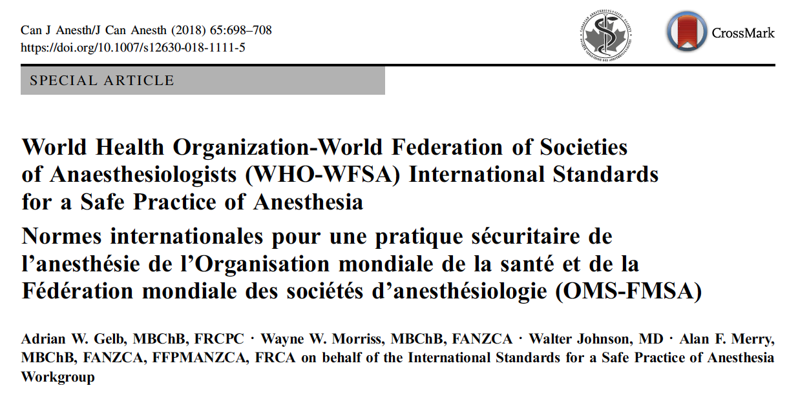
Expert Consensus on Minimum Anesthesia Requirements for Cesarean (MARC): A Delphi Study
Ronald B. George, Ashraf Habib, Cynthia Wong, David Bishop, Dominique Van Dyk, Robert Dyer, and MARC study investigators
1 in every 14 operations worldwide are a Cesarean delivery
Global Cesarean rate increasing - 21% - 29.7 Million births
2018 WHO-WFSA International Standards for a Safe Practice of Anesthesia
Access to safe anesthesia for essential surgery is a basic human right
WHO Level 2 - District/Provincial hospital - Cesarean capable
Notes:
1 in every 14 operations worldwide are a Cesarean delivery
Global Cesarean rate increasing - 21% - 29.7 Million births
In 2018 WHO-WFSA International Standards for a Safe Practice of Anesthesia were published
They are intended to provide guidance and assistance to anesthesia providers, their professional organizations, hospital and facility administrators, and governments for maintaining and improving the quality and safety of anesthesia care.
They also ascribed that access to safe anesthesia for essential surgery is a basic human right
and highlight that WHO Level 2 - District/Provincial hospital - Cesarean capable
CD is a common and critical procedure for which safety could be improved with practical minimal requirements for anesthesia and further prioritization of these requirements that takes into consideration the resources available in LMICs. International expert consensus from a diverse group of anesthesiologists has the potential to contribute to maternal and fetal safety, especially in LMICs where 99% of the estimated worldwide maternal mortality falls.

Slide 2
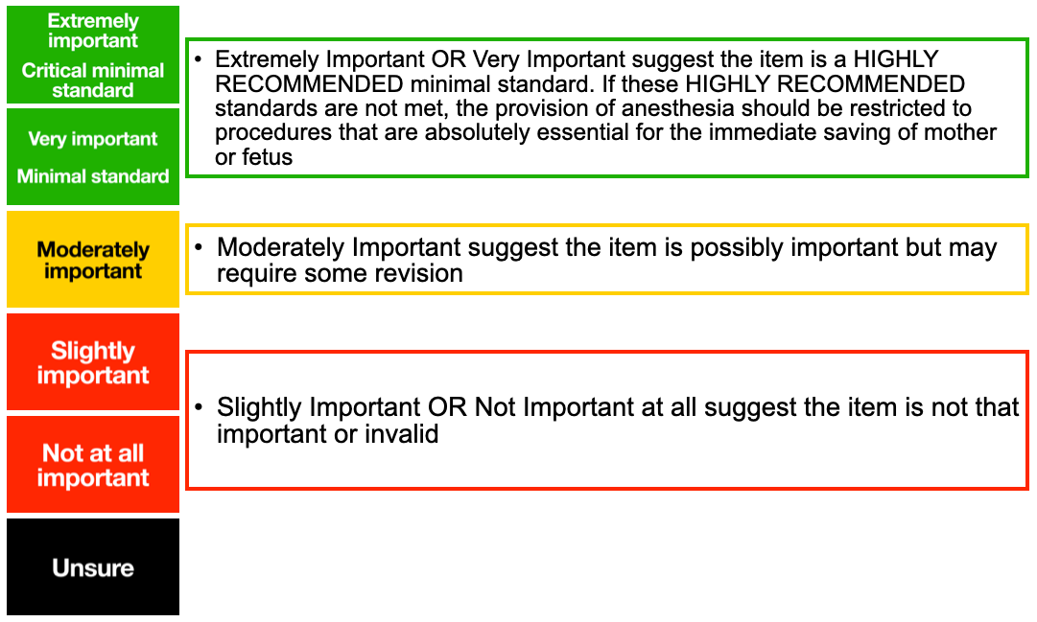
Anesthesia Personnel
Institutional Requirements
Medications
Patient Monitoring
Airway Mgmt
≥ 75% rated as “Extremely Important” or “Very Important” = consensus for inclusion
≥ 75% rated as “Slightly Important” or “Not Important at all” = consensus exclusion
#SOAPAM2025
Notes:
The study was conducted by a Steering Group and a panel of international collaborators who are experts in obstetric anesthesia with geographic representation from all 6 WHO regions and with representatives from high-, middle-, and low-income countries
The comprehensive list of categorized requirements was sent to all participants. These outcomes were grouped by the study steering committee as follows: Anesthesia personnel, drugs, airway management, patient monitoring, and institutional requirements.
All participants completed each round of Delphi questionnaires, attended round-table meetings between each Delphi rounds, where data was reviewed and interpreted.
During Delphi participants used a 5-point likert scale ranging from extremely Important to not important at all. The participants were also given the opportunity to suggest any other requirements or modifications to existing requirements.
“Extremely important” or “very important” suggests the item is a highly recommended minimal standard
≥ 75% rated as “Extremely Important” or “Very Important” = consensus for inclusion
≥ 75% rated as “Slightly Important” or “Not Important at all” = consensus exclusion

Slide 3
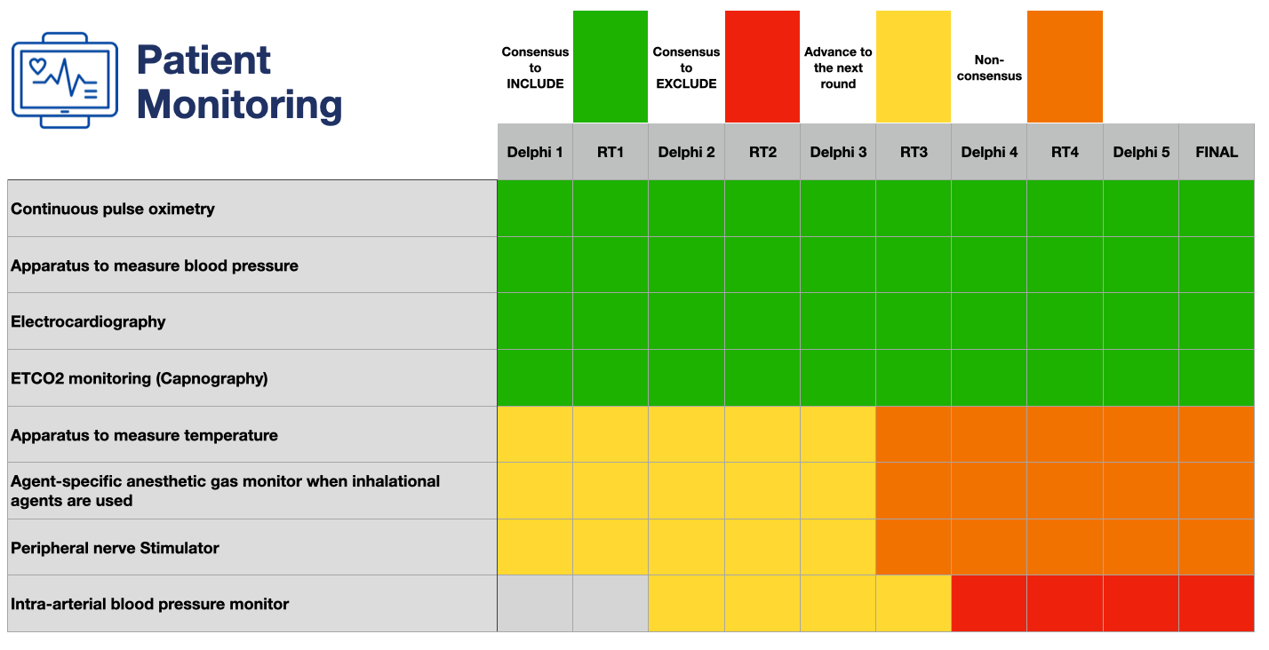
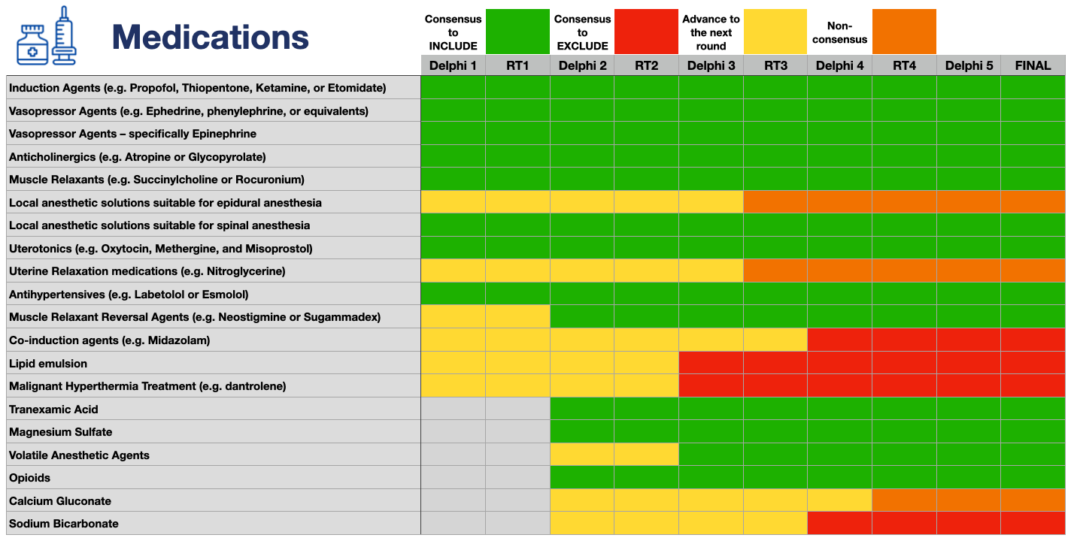
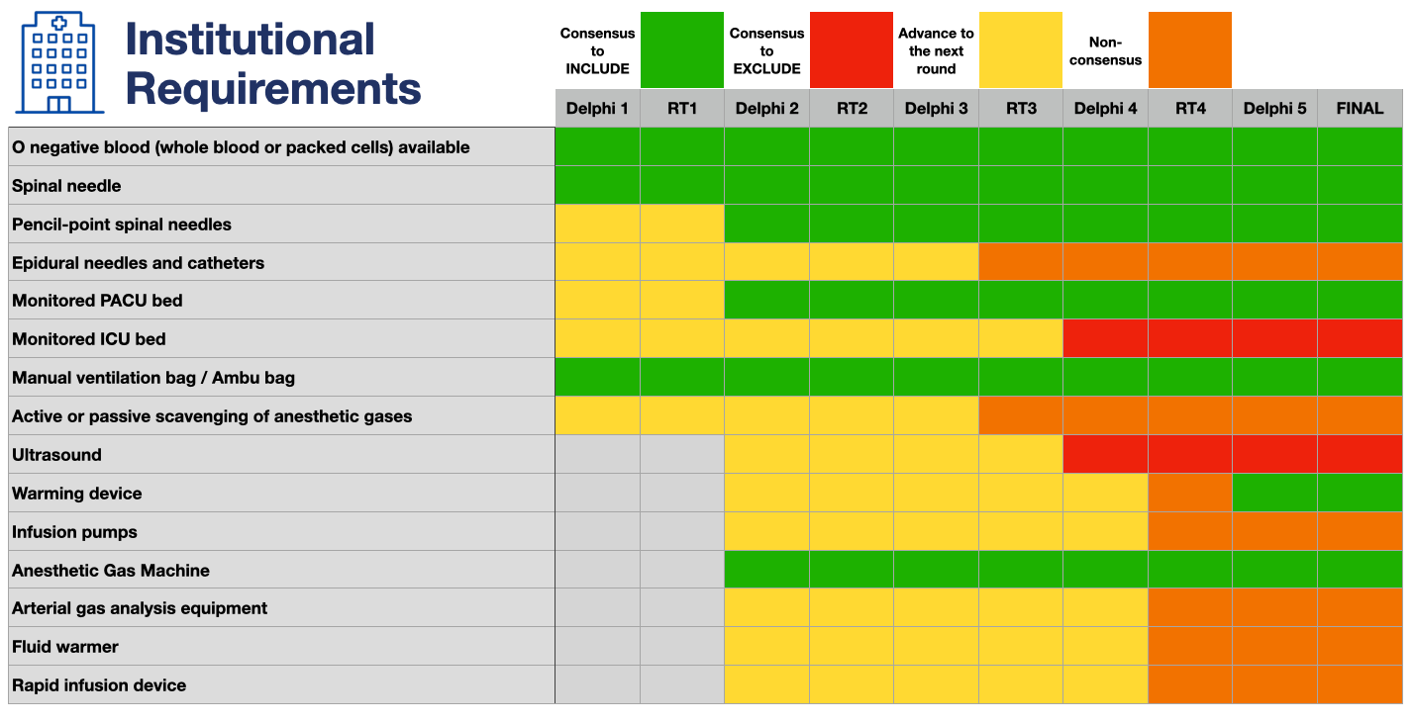
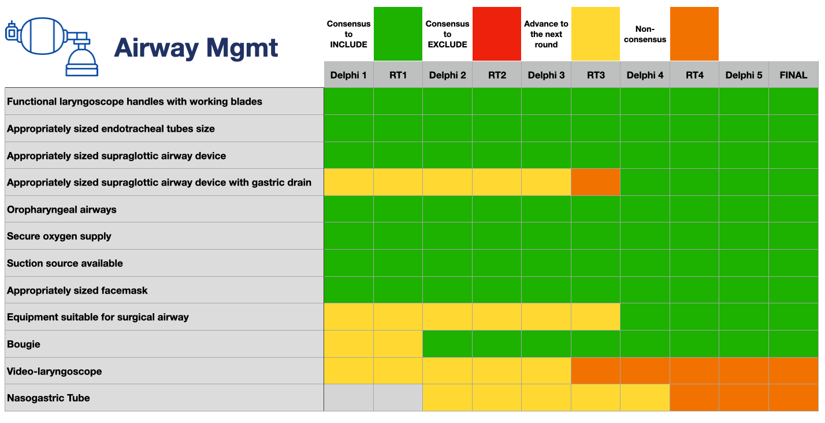
#SOAPAM2025

Slide 4
Anesthesia Personnel
 | Consensus to INCLUDE |  | Consensus to EXCLUDE |  | Advance to the next round |  | Non-consensus
 | Delphi 1 | RT1 | Delphi 2 | RT2 | Delphi 3 | RT3 | Delphi 4 | RT4 | Delphi 5 | FINAL
Spinal anesthesia can only be provided by anesthesia providers with competency in GA-ET?
Should be present and responsible:
Obstetric Anesthesiologist
Anesthesiologist
Non-specialist Physician Anesthesiologist
Nurse Anesthetist
Other Healthcare Provider
Obstetric Anesthesiologist must be present and responsible
Physician Anesthesiologist must be present and responsible
Non-specialist Physician Anesthetist Provider (i.e. a non-Anesthesiologist Physician, e.g. Family Practitioner Anesthetist) can be solely responsible
Non-Physician Anesthesia Provider (e.g., Nurse anesthetist, Anesthetic officers [not a medical doctor], technicians, or assistants) can be solely responsible
Any competant Anesthesia Provider (Physician, non-specialist Physician or non Physician) can be solely responsible for anesthesia care
IF primary Anesthesia Provider is NOT deemed competent for independent practice, an Anesthesia Provider who is competent must be immediately available
#SOAPAM2025

Slide 5
Conclusions
Induction Agents
Vasopressor Agents
Vasopressor Agents (Epinephrine)
Anticholinergics
Muscle Relaxants
Local anesthetics (spinal)
Uterotonics
Antihypertensives
Muscle Relaxant Reversal Agents
Tranexamic Acid
Magnesium Sulfate
Volatile Anesthetic Agents
Opioids
Local anesthetics (epidural)
Uterine Relaxation meds
Calcium Gluconate
Sodium Bicarbonate
Co-induction agents
Lipid emulsion
Malignant Hyperthermia Treatment
Laryngoscope handles & blades
Endotracheal tubes
Supraglottic airway device
Supraglottic airway device with gastric drain
Oropharyngeal airways
Secure oxygen supply
Suction source available
Appropriately sized facemask
Equipment suitable for surgical airway
Bougie
Video-laryngoscope
Nasogastric Tube
O negative blood
Spinal needle
Pencil-point spinal needles
Monitored PACU bed
Manual ventilation bag / Ambu bag
Warming device
Anesthetic Gas Machine
Arterial gas analysis equipment
Fluid warmer
Rapid infusion device
Epidural needles and catheters
Infusion pumps
Active or passive scavenging
Ultrasound
Monitored ICU bed
Continuous pulse oximetry
Apparatus to measure blood pressure
Electrocardiography
ETCO2 monitoring (Capnography)
Apparatus to measure temperature
Agent-specific anesthetic gas monitor
Peripheral nerve Stimulator
Intra-arterial blood pressure monitor
#SOAPAM2025
Notes:
Local anesthetics for spinal anesthesia
Local anesthetics for epidural anesthesia
ET CO2
Arterial catheters
Supraglottic airway tools
Video laryngoscopy
O-negative blood
Pencil point spinal needle
ultrasound

Slide 6
Conclusions
Spinal anesthesia should only be provided when their are anesthesia providers with competency in GA-ET immediately available
Any competent Anesthesia Provider (Physician, non-specialist Physician or non Physician) can be solely responsible for anesthesia care
IF primary Anesthesia Provider is NOT competent for independent practice, an Anesthesia Provider who is competent must be immediately available
#SOAPAM2025
Notes:
For routine, scheduled cesarean delivery in a Level 2 District/Provincial Hospital in a low or middle income country….

