Slide 1
Multidisciplinary Approach for Managing a Patient with Fontan Circulation for Tricuspid Atresia and Placenta Accreta
Geoffrey Elder, Reda Hafiane, Elizabeth Miller, Mohamed Eissa
University of Ottawa, Canada
May 1, 2025

Slide 2
Background
Fontan Circulation
Placenta Accreta Spectrum
Single ventricle circulation with passive pulmonary circulation
Physiology is heavily reliant on preload for hemodynamic stability
Advancement in surgical and medical care has allowed for significant improvement patient survival
Abnormal invasion of the uterine wall
Portends a predictable risk of requiring a Massive Transfusion Protocol
Notes:
Accreta:
American College of Obstetricians and Gynecologists.
Committee Opinion No. 529: Placenta accreta. Reaffirmed
2017. Obstet Gynecol. 2012;120:207–211.
Stotler B, Padmanabhan A, Devine P, et al. Transfusion
requirements in obstetric patients with placenta accreta.
Transfusion. 2011;51:2627–2633.

Slide 3
Case Description
The patient
Management
22 y.o. Primigravida with tricuspid atresia, ASD and VSD who had undergone Fontan repair.
TTE Findings:
Respirophasic flow from the venae cava into the PA
Normal LV size and function with LVEF > 55%
An atretic RV
Abdominal ultrasound revealed placenta previa.
3 episodes of APH during gestation.
31+5: Multidisciplinary meeting held to plan delivery
33+5: She represents to hospital with APH
Cesarean completed under epidural anesthetic in the main OR
Healthy Baby boy delivered
PPH secondary to placenta accreta
Prompt execution of Hysterectomy
Notes:
Meeting included:
Anesthesia
OB
Cardiology
Pediatrics
MDT meeting with a decision for an elective CS at 36 weeks.
Management of possible PPH was discussed given the devastating impact of hypovolemia on FC.
With limited options, not able to give ergots or it Hemabate was decided that any placental adherence would require hysterectomy.

Slide 4
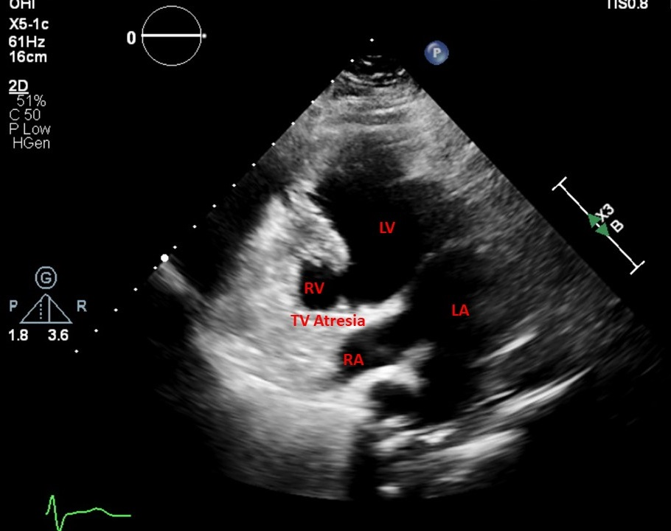
Discussion
A c-section is a life-threatening situation for patients with congenital heart disease.
Fontan circulation is physiologically dependant on preload.
Possibility of hysterectomy had been pre-emptively discussed with the patient.
Extensive multidisciplinary planning and counselling enabled rapid, effective response.

