Slide 1
Adjuvant Analgesic, Anxiolytic, and Sedative Medications Administered During Cesarean Delivery A Retrospective Report from the Multicenter Perioperative Outcomes Group Research Consortium
Eric Y. Chen, MD, MBA
Obstetric Anesthesiology Fellow
Brigham and Women’s Hospital | Harvard Medical School
*No disclosures
Notes:
Good morning, my name is Eric Chen, and I am currently an obstetric anesthesia fellow at Brigham and Women’s Hospital. I will be presenting our study investigating the use of adjuvant medications during cesarean deliveries under neuraxial anesthesia.

Slide 2
Background
Neuraxial anesthesia is the preferred anesthetic technique for cesarean delivery
IV or inhalational medications may be used to supplement when neuraxial is inadequate
Supplemental analgesia is a recommended ASA quality metric
Data regarding frequency and factors driving their use are lacking
Aims:
Estimate the percentage of patients who received adjuvant medications and/or were converted to general anesthesia
Estimate the association of patient, case, and hospital-level characteristics
Notes:
As we are all aware, neuraxial anesthesia, in the absence of contraindications, is the preferred anesthetic technique for cesarean delivery when compared to general anesthesia given the decreased risk of associated maternal morbidity and mortality. However, inadequate anesthesia can result in patient discomfort and traumatic patient experiences, both physical and psychological, with one study showing anesthesia complications to be an independent risk factor for postpartum PTSD (Lopez 2017). In such cases, IV or inhalational medications can be used to supplement neuraxial anesthesia. Prior smaller studies have found the prevalence of supplemental medications to range from 10-15% (Bauer 2012, Patel 2022). A recent observational study showed that not all women who report pain during cesarean delivery received adjuvant medication while some who did not report pain did receive adjuvant IV medication (Sanchez 2024).
The primary aim of our study was to estimate the percentage of patients undergoing cesarean delivery under neuraxial anesthesia who received IV or inhaled analgesic, anxiolytic, or sedative medications, or were converted to general anesthesia – this was our composite outcome. We then estimated the association of patient, case, and hospital-level characteristics with the odds of the composite outcome.

Slide 3
Methods
Inclusion criteria:
All anesthetic records for cesarean delivery under neuraxial anesthesia
2018-2023
Exclusion criteria
Institutions with less than 500 total cases
Repeat procedures for the same patient
Medications:
Opioids
Midazolam
Propofol
Ketamine
Dexmedetomidine
Nitrous oxide
Conversion to GA
Notes:
We conducted a retrospective, observational cohort study using the Multicenter Perioperative Outcomes Group or MPOG database.* MPOG is a consortium of hospitals with a shared dataset to facilitate research on perioperative outcomes. We included all patients who underwent cesarean delivery under neuraxial anesthesia between January 1, 2018 and December 31, 2023 at over 60 MPOG institutions. With regards to the medications we looked at, we included IV opioids, midazolam, propofol, ketamine, dexmedetomidine, and inhaled nitrous oxide given during cesarean delivery. Since many of these medications can be given during conversion to general anesthesia, we excluded any administrations from the 5 minutes preceding intubation time and onwards. We also excluded small doses of opioids to account for possible documentation error of neuraxial opioids as IV.
*MPOG was founded in 2008 to facilitate the investigation of perioperative outcomes, and each institution in this consortium extracts and then exports data into a shared database. Each institution also performs data and case validation to ensure adequate data quality and consistency.

Slide 4
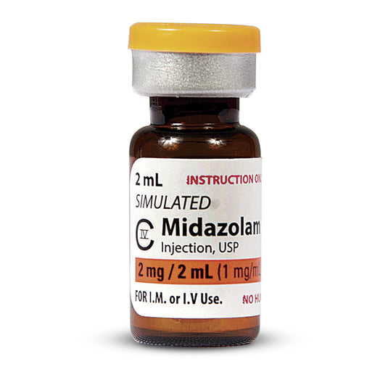
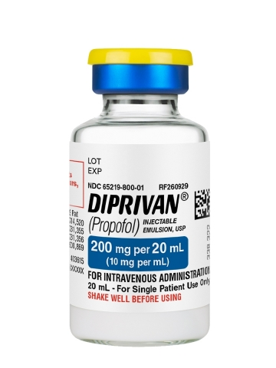
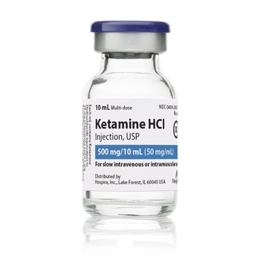
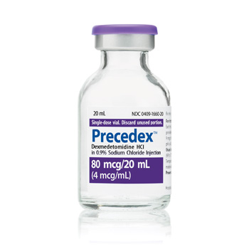
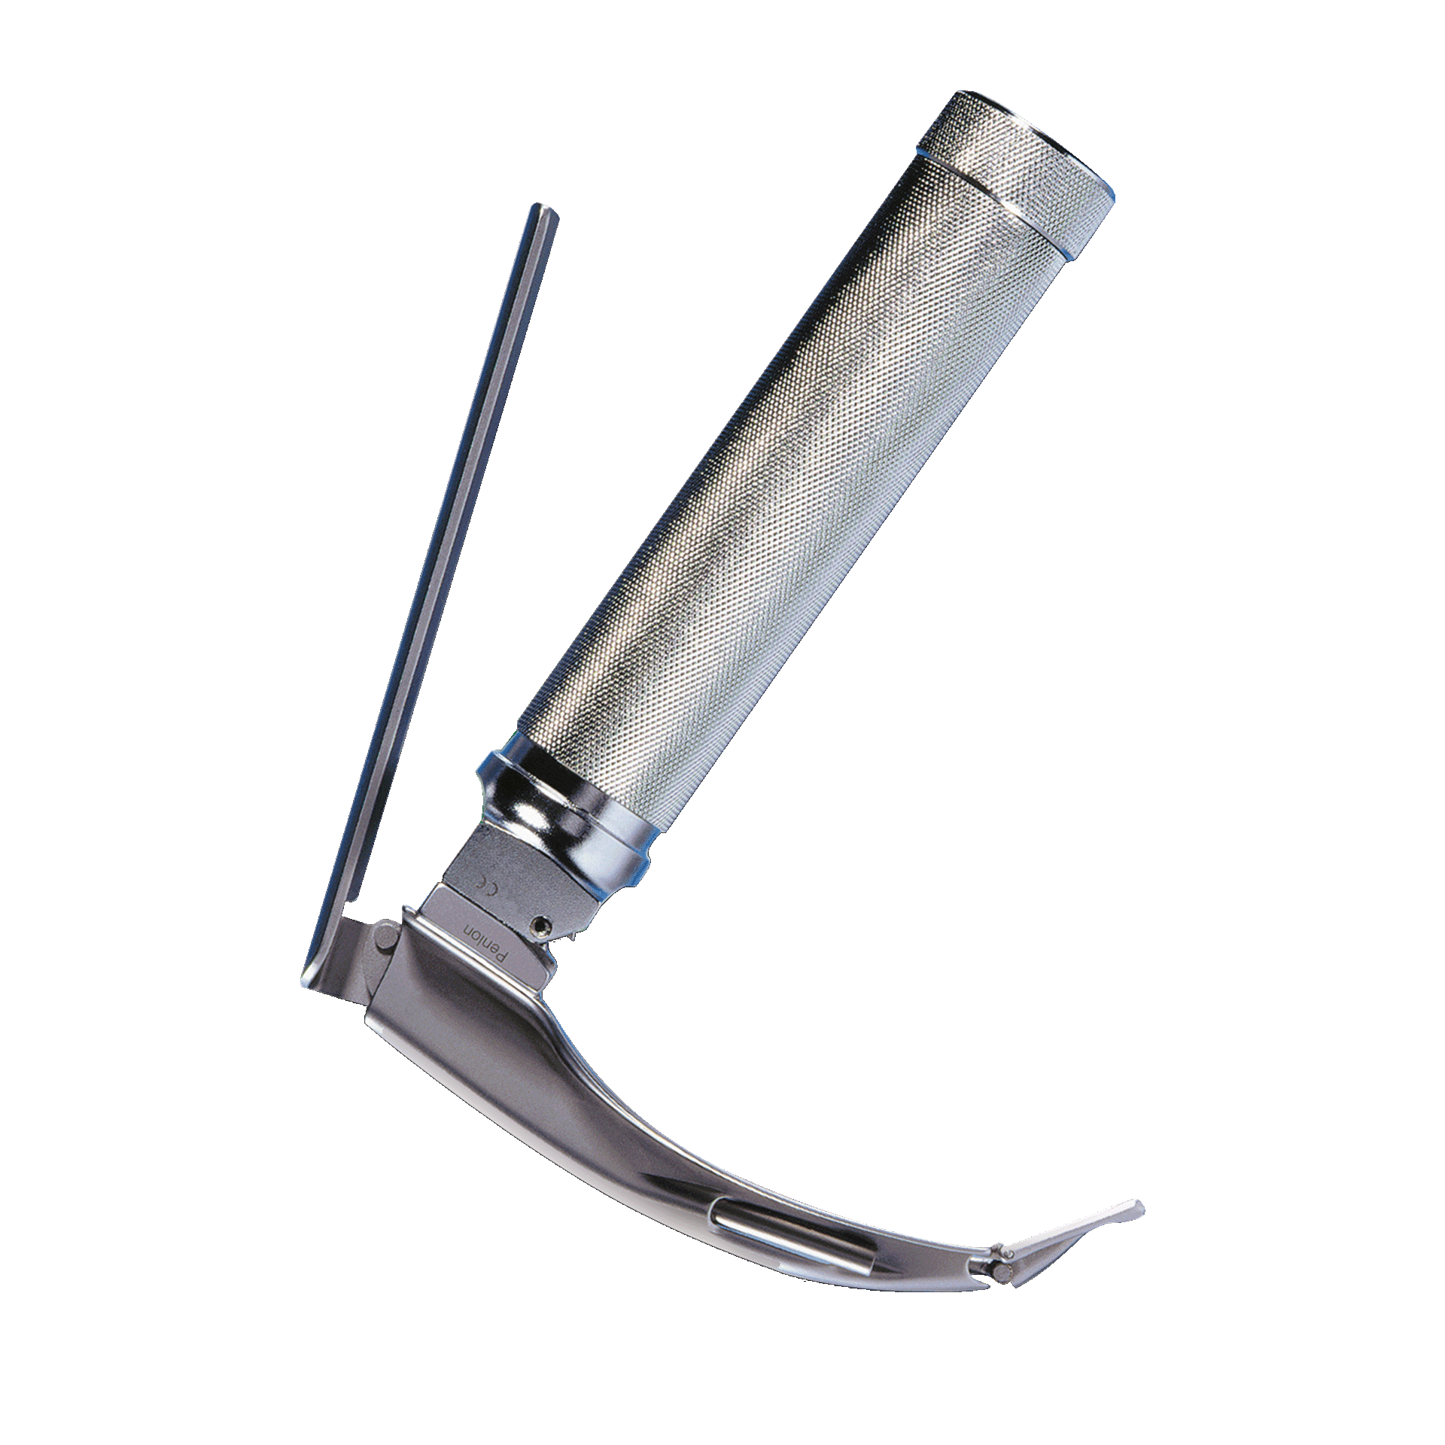
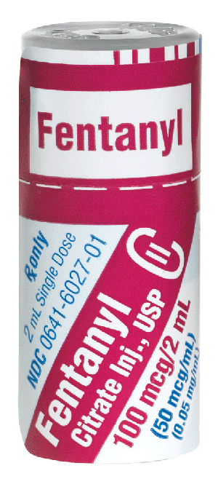
Results
166,196 cesarean deliveries under neuraxial anesthesia
Spinal 58%
CSE 34%
Epidural 8%
33 555 cases of adjuvant medication and/or conversion to GA (20%)
18.2%
13.8%
11.1%
5.1%
4.4%
2.1%
1.3%
Notes:
After the exclusion of cases with missing data, we found 166 196 cases of cesarean delivery under neuraxial anesthesia. Of these cases, 58% of them were performed under spinal anesthesia, 34% under combined spinal epidural, and 8% under epidural anesthesia. Of these cases, 33 555 cases (or around 20%) involved the use of adjuvant medications or were converted to general anesthesia. Of note, nearly all these patients received fentanyl at an incidence of 18.2%, while morphine was given to 4.5% of patients and hydromorphone only 1.9%. Only 1.3% of patients were converted to general anesthesia.

Slide 5
Results – Patient Characteristics
 | Odds Ratio (99% CI) | p-value
BMI (Ref < 30)
40-50 | 0.69 (0.65, 0.73) | < 0.01
50+ | 0.65 (0.60, 0.72) | < 0.01
Race (Ref White)
Asian/Pacific Islander | 0.70 (0.65, 0.76) | < 0.01
Black | 1.10 (1.05, 1.15) | < 0.01
Hispanic | 0.95 (0.87, 1.03) | 0.11
ASA Class (Ref 1/2)
3 | 1.12 (1.08, 1.17) | < 0.01
4 | 1.90 (1.58, 2.29) | < 0.01
Notes:
To look at the various factors affecting the use of adjuvant medications, we used a generalized linear mixed model. Here we present the odds ratios with 99% confidence intervals for the various patient and case factors. From our model, we found that several patient factors were correlated with the use of adjuvant medications. For example, it was less likely for adjuvants to be given to patients with higher BMIs when compared to patients of BMI <30. Patients of Asian or Pacific Islander race were also less likely to receive adjuvants when compared to White patients while Black patients were more likely to receive adjuvants. Finally, patients of ASA class 4 were more likely to receive adjuvants when compared to ASA class 1 and 2.

Slide 6
Results – Comorbidities
 | Odds Ratio (99% CI) | p-value
Preterm Delivery | 1.34 (1.26, 1.42) | < 0.01
Pre-eclampsia | 1.12 (1.06, 1.18) | < 0.01
Chorioamnionitis | 1.32 (1.21, 1.43) | < 0.01
Labor to Cesarean | 1.03 (0.92, 1.15) | 0.53
Induction of Labor | 1.29 (1.18, 1.41) | < 0.01
Notes:
Looking at patient comorbidities, we found that preterm delivery, pre-eclampsia, chorioamnionitis were all associated with increased odds of adjuvant administration. Patients being induced for labor also had an increased chance of adjuvant administration. Surprisingly, there was no significant difference between planned cesarean deliveries versus conversion to cesarean from labor, but this might be due to how conversions are reported and documented at different institutions.

Slide 7
Results – Anesthesia Factors
 | Odds Ratio (99% CI) | p-value
Time of Day (Ref Day 0700 – 1659)
Evening (1700 – 2259) | 1.17 (1.12, 1.22) | < 0.01
Overnight (2300 – 0659) | 1.22 (1.16, 1.28) | < 0.01
Anesthesia Technique (Ref Spinal)
Combined Spinal Epidural | 1.47 (1.42, 1.54) | < 0.01
Epidural | 2.96 (2.76, 3.18) | < 0.01
Medical School Affiliation | 0.63 (0.40, 0.98) | 0.01
Notes:
A couple of non-patient related factors also influenced the use of adjuvants. We found that there was an increase in the use of adjuvants in the evening and overnight when compared to the daytime. The anesthesia technique also had a big influence as patients with an epidural were almost 3 times as likely to receive adjuvants when compared to spinal anesthesia and those with a CSE were 1.5 times as likely. Lastly, we found that having a medical school affiliation led to a decreased likelihood of adjuvant administration. While our model does account for variation due to institution, we are still investigating the dependence on features of the institution using a hierarchical model. This variation could reflect a difference in having OB fellowship trained anesthesiologists, especially overnight, which could also account for the increased use of adjuvants when compared to daytime. Stay tuned for more on this in the next Gertie Marx presentation.

Slide 8
Conclusions
20% of patients under neuraxial anesthesia required supplementation and/or conversion to GA
Opportunities for improvement?
Frequency of labor epidural analgesia evaluation
Block testing technique
Highlights the importance of providing high quality neuraxial anesthesia
Co-Investigators:
Adjuvants can have undesirable side effects
Pervez Sultan, MBChB | Mohamed Tiouririne, MD
Nadir Sharawi, MBBS | Samuel Justice, PhD
Kara Fields, MA | David Stein, PhD
Michael Furdyna, MD | Sharon Reale, MD
Notes:
There are several limitations to our study. While certain patient and case factors might have correlated with adjuvant medication use, we unfortunately cannot make any causal inferences as to why certain medications were administered. For example, 13.8% of patients received midazolam. Was this given for pain or simply for anxiety? Was it ever given in isolation or always with other analgesic medications? Other medications like dexmedetomidine might have been given for shivering instead of pain.
In summary, we found that nearly 20% of patients undergoing cesarean delivery with neuraxial anesthesia received IV adjuvants, which is higher than previously reported in literature. The group of patients that most likely needed adjuvant medications had an epidural as their mode of anesthesia. This suggests that we may need to revisit the frequency of labor epidural analgesia evaluations and neuraxial block testing prior to incision. In addition, there were several important factors associated with adjuvant medication administration, including ASA class 4, preterm delivery, chorioamnionitis, overnight cases, and a community practice setting. Overall, I think our study highlights the importance of providing high quality neuraxial anesthesia to avoid giving adjuvants that can have undesirable side effects like nausea, somnolence, respiratory depression, and dissociation. We should have conversations with our patients about their wishes, remembering that “sedation is not a treatment for pain and not a substitute for general anesthesia.” While we do not want our patients to be in pain, our goal should be first to prevent, rather than simply manage intraoperative pain. Thank you.

