Slide 1


ANESTHETIC CONSIDERATIONS FOR PARTURIENT WITH BMI >100 KG/M²
Mariam Batakji, M.D., Maria Muravyeva M.D., Ph.D , Meredith Albrecht, M.D., Ph.D.
Medical College of Wisconsin, Milwaukee, WI
Background
Background: Parturient with BMI > 70 kg/m², referred as ultra obesity, present unique challenges for anesthesiologists.
Considerations:
thorough preoperative assessment
equipment
choice of anesthetic techniques
drug dosing adjustments
adequate IV access
hemodynamic monitoring
Case
28yo F G1P0 evaluated in high-risk OB Anesthesia clinic due to BMI of 107 (240 kg, 150cm)
PMH: pseudotumor cerebri, Hyrtl’s fissure, OSA and lymphedema of lower extremities
IOL was scheduled at 37 weeks due to maternal comorbidities:
  Bariatric bed placed in labor room
  Bariatric bed placed in OR in preparation for delivery (stirrups cannot be attached to regular bariatric bed)
  Pre procedural US (ACCURO) device utilized to identify landmarks for epidural insertion on day of admission

Slide 2
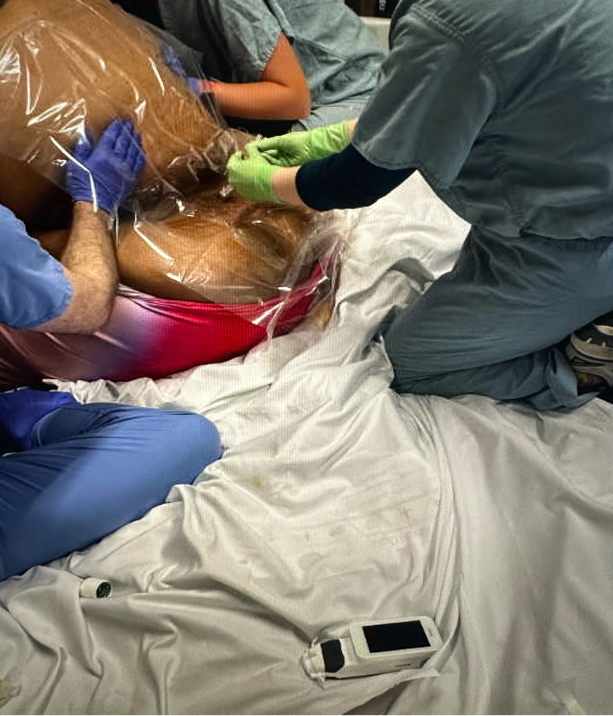
ANESTHETIC CONSIDERATIONS FOR PARTURIENT WITH BMI >100 KG/M²
Mariam Batakji, M.D., Maria Muravyeva M.D., Ph.D , Meredith Albrecht, M.D., Ph.D.
Medical College of Wisconsin, Milwaukee, WI
Epidural Insertion:
  DPE (25G spinal needle) placed at L3-4 lumbar level, LOR 10cm
  Placement required the presence of multiple team members for positioning
  Catheter incrementally bolused with 4 ml 0.125% bupivacaine
  PIEB (8ml Q 60 min) + PCEA (6ml Q 20 min) - 0.1% bupivacaine + 2mcg/ml fentanyl
  Epidural provided adequate labor analgesia for 40hrs
Emergent CD:
  Approach: upper abdomen, vertical midline incision
  Epidural bolus 18ml of 2% lidocaine + 2ml of sodium bicarbonate
  Additional boluses of chlorprocaine during surgery and supplemental IV analgesia

Slide 3

ANESTHETIC CONSIDERATIONS FOR PARTURIENT WITH BMI >100 KG/M²
Mariam Batakji, M.D., Maria Muravyeva M.D., Ph.D , Meredith Albrecht, M.D., Ph.D.
Medical College of Wisconsin, Milwaukee, WI
Discussion and Conclusion
There are very limited case reports describing obstetric and anesthetic management for parturients with BMI > 100 kg/m².
Our case is unique in that labor analgesia was provided initially for planned normal VD using PIEB regimen then progressed to CD.
To our knowledge, this is first case report describing DPE technique and PIEB regimen for BMI >100 kg/m².
This case highlights the importance of preprocedural neuraxial US and its role in facilitating insertion.
Awareness and preparation requires careful planning and communication among multiple teams.
References
Nivatpumin P, Lertbunnaphong T, Maneewan S et al. Comparison of perioperative outcomes and anesthetic-related complications of morbidly obese and super-obese parturient delivering by cesarean section. Ann Med. 2023 Dec;55(1):1037-1046.
Mossie A , Ali S.A. , Tesema H.G. Anesthetic implications of morbid obesity during pregnancy; a literature-based review. International Journal of Surgery Open.2022; volume 40, ISSN 2405-8572
Bracken O, Langhe R. Evaluation of maternal and perinatal outcomes in pregnancy with high BMI. Ir J Med Sci. 2021 Nov;190(4):1439-1444.

