Slide 1
Severe Perioperative Surgical Morbidity in Patients Undergoing Cesarean Delivery In California, 2016 - 2021
Authors: A.J. Butwick MBBS, FRCA, MS ¹; R.J. Baer PhD ^{2,3}; N. Farooqi FACOG ⁴; O Stephansson MD PhD ⁵; L. Jelliffe-Pawlowski PhD MS ^{3,6}
Institutions: ¹Department of Anesthesia & Perioperative Care, UCSF; ²Department of Pediatrics, UCSD; ³California Preterm Birth Initiative, UCSF; ⁴Department of Obstetrics and Gynecology, UCSF; ⁵Department of Obstetrics, Karolinska University Hospital; ⁶NYU Rory Meyers College of Nursing

Slide 2
INTRODUCTION
Cesarean Delivery (CD): Most common surgical procedure
>1.1 million; 32% all births – US (2023) ¹
Limited data – CD surgical-related morbidity
CDC severe maternal morbidity index: not CD specific; only 1 surgical morbidity indicator ²
Few epidemiologic studies ^{3,4}
Hamilton BE. Vital Statistics Rapid Release (CDC); no 35. April 2024
National Center for Chronic Disease Prevention and Health Promotion
Larsson. PLoS ONE 2021; 16: e0258222
Sheikh. Am J Obstet Gynecol MFM 2020;2:100071
Notes:
Intro: CS is the most common inpatient surgical procedure globally and in the US
Provide US stats for this.
Yet, despite its frequency, we have relatively limited info about the frequency and extent of surgical complications that occur during CS for several reasons:
1. Maternal morbidity indices predominantly account for medical complications. For example – out of 21 indicators of morbidity in the CDC SMM index – only 1 is a surgical morbidity (hyst).
2. Few studies of morbidity differentiate surgical from medical complications
Approximately -- 1,163,590.272 cesareans in 2023.

Slide 3
Primary Aim:
Quantify the prevalence of severe perioperative surgical morbidity (SPSM) in patients undergoing cesarean delivery
Secondary Aims:
Quantify the SPSM prevalence in patients undergoing prelabor (elective) and intrapartum cesarean delivery
Identify potential risk factors for SPSM

Slide 4
METHODS
Study Design: Population-based cross-sectional study - linked California Birth Certificate – Maternal Discharge records
Study Cohort: Singleton pregnancies; CDs; 2016 – 2021 (n=594,655)
Primary Outcome: Composite measure of surgical morbidity (ICD-10 codes):
Bowel, bladder, genitourinary/pelvic, uterine injury; broad ligament hematoma; pelvic/retroperitoneal hematoma; hysterectomy; vascular injury; wound complication; ileus/bowel obstruction; acute peritonitis; shock
Statistical Analyses:
Proportions – overall; prelabor vs intrapartum cesarean delivery; individual morbidities
Poisson log-linear regression - Associations between potential predictors (patient and hospital characteristics) and SPSM

Slide 5
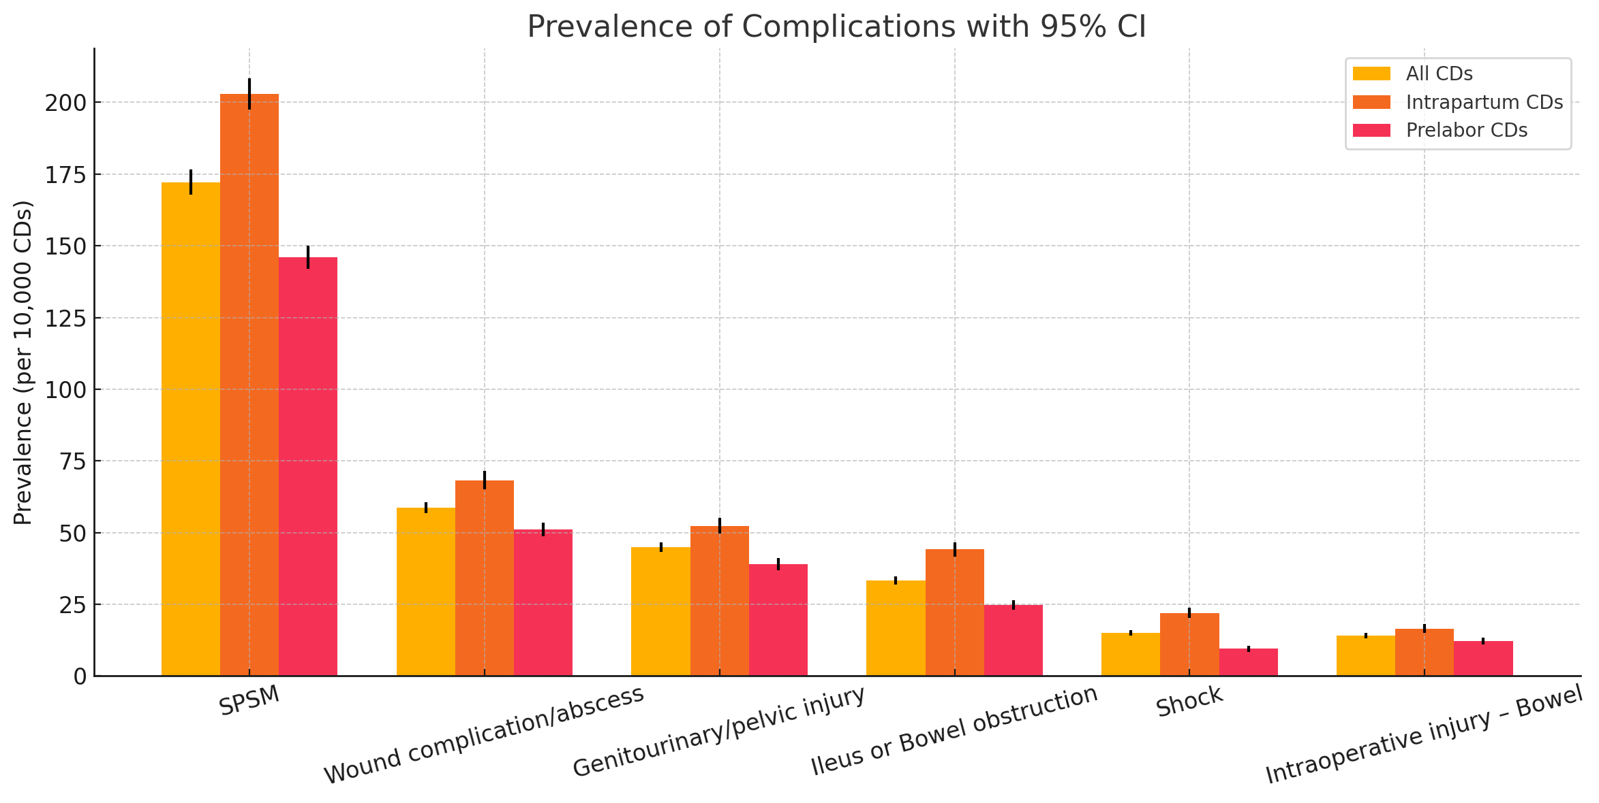
RESULTS
 | All Cesareans aRR (95% CI) | Prelabor Cesarean aRR (95% CI) | Intrapartum Cesareans aRR (95% CI)
Placenta Accreta | 16.1 (14.7 – 17.5) | 17. 9 (16.0 – 19.9) | 11.0 (9.3 – 13.0)
Chorioamnionitis | 2.1 (1.9 – 2.2) | N/A | 2.0 (1.8 – 2.1)
Maternal Age ≥ 35 y (ref = 20 – 24 y) | 1.8 (1.7 – 2.0) | 1.8 (1.6 – 2.1) | 1.9 (1.7 – 2.1)
Labor or Induction of Labor | 1.7 (1.6 – 1.8) | N/A | N/A
Placenta Previa | 1.5 (1.3 – 1.6) | 1.5 (1.3 – 1.6) | 1.3 (1.1 – 1.6)
Model includes: maternal age; race/ethnicity; insurance; highest educational level; BMI; chronic hypertension; prior cesarean; placenta previa; placenta accreta; hypertensive disorder of pregnancy; labor/induction; gestational age; hospital type (teaching/non-teaching); hospital location (urban/rural); annualized CD volume

Slide 6
CONCLUSION
Main findings:
1st study –severe surgical morbidity index in CD
SPSM prevalence: 1.7% (1 in 59 CDs)
Higher prevalence: intrapartum vs prelabor CD (2.0% vs 1.5%)
Placenta accreta – very strong risk factor - SPSM (aRR 16)
Study Strengths: Large contemporary population; generalizability
Limitations: ICD-10 codes – morbidity; no timestamps for morbidity events; no data on long-term outcomes
Further study: Validate measure; Assess ~ potential metric for surgical quality of care
Email: alexander.butwick@ucsf.edu

