Slide 1
Profiling postpartum recovery: a multicenter longitudinal cohort study
Takenoshita M, Guo N, Farber M, Toledo P, Higgins N, Carvalho B, Sultan P.
Dept. of Anesthesiology, Perioperative and Pain Medicine, Stanford University
Background
AIMS
Outpatient recovery is poorly understood
PRIMARY: Characterize longitudinal postpartum recovery
Pregnancy
Delivery
Inpatient
Day 7 to Day 365 postpartum
SECONDARY:
Profile recovery for each domain
Compare delivery modes
Compare parity
Compare domains between best and worst scores
32.1%
67.9%
Timing of deaths postpartum (day of delivery to 1 year postpartum)
STanford Obstetric Recovery checKlist (STORK)
Patient reported outcome measure: 47 questions, 5 response options
STORK Domain | No. of questions | Max. score
Physical | 13 | 52
Mental & emotional health | 15 | 60
Motherhood experience & social support | 12 | 48
Sleep & fatigue | 7 | 28
Total | 47 | 188
Physical | Mental & Emotional Health | Motherhood experience & Social support | Sleep & Fatigue
Sultan et al. JAMA Network Open.2025. In Press
Trost et al. Pregnancy-Related Deaths: Data From Maternal Mortality Review Committees in 36 US States, 2017-2019. CDC. 2022.
Hoyert DL. Health E-Stat: Maternal Mortality Rates in the United States, 2022.; 2024.
Notes:
maternal mortality rates have risen since 2019,³ and far exceed those of other high-income countries
Maternal Mortality Rate in US: 18.6 deaths per 100,000 (2023) - Vs 2 in Norway for the same year (almost TEN FOLD) (while pregnant or within 42 days of termination of pregnancy)
CLICK
Most occur following hospital discharge (CDC Trost S, Beauregard J, Chandra G. Pregnancy-Related Deaths: Data From Maternal Mortality Review Committees in 36 US States, 2017-2019.)
Among pregnancy-related deaths with information on timing, 53% occurred 7–365 days postpartum. https://www.cdc.gov/maternal-mortality/php/data-research/mmrc-2017-2019.html
85% deaths classified as preventable
Our understanding of postpartum recovery after hospital discharge has been limited
Partly because we did not have the right tools to measure postpartum recovery in outpatient setting
CLICK
"STORK is a 47-question questionnaire with 5 response options on a scale from Not at all to Very much. The total possible score is 188. A higher score indicates better recovery. It measures postpartum recovery across 4 domains: physical health, mental and meotional health and mother hood experience and social support, and sleep and fatigue. I will be referring to these icons to represent these domains throughout this presentation.“
CLICK
Our PRIMARY aim…
CLICK
Our SECONDARY AIM

Slide 2
Methods
SITES
Stanford University
Brigham & Women’s Hospital Northwestern University
STRATEGY
IRB approval
300 completed 6-week responses
INCLUSION English-speaking
Live fetus
DATA Patients completed STORK:
Inpatient, 2, 6, & 12 weeks postpartum
Demographic, obstetric, medical variables
Physical | Mental & Emotional Health
OUTCOMES Descriptive summaries of STORK scores
Individual domain STORK scores
Motherhood experience & Social support | Sleep & Fatigue
ANALYSIS
Categorical variables: Chi-square test or Fishers’ exact test
Continuous variables: One-way ANOVA or Kruskal–Wallis test
Mixed linear effect model to compare mean STORK score over time
Notes:
Patients were recruited within the first 36 hours of delivery at three geographically diverse US academic centers
Inclusion criteria: delivered by any delivery mode including spontaneous and operative vaginal delivery and cesarean delivery (both scheduled and unscheduled); any gestational age, parity and all gestations (singletons or twins); and all anesthesia modes for patients undergoing cesarean delivery and all methods for labor analgesia including non-pharmacologic or no interventions.
Exclusion criteria: unable to read or understand written English
Recruitment continued until 300 6 week responses had been achieved
CLICK
Patients were invited to complete STORK at recruitment, then at 2, 6, and 12 weeks postpartum.
Our outcomes were: descriptive summaries of STORK scores, and individual domain scores across 12 weeks.
CLICK
Statistical analysis:
Chi-square test or Fishers’ exact test were used to compare the frequencies of categorical variables and one-way analysis of variance or Kruskal–Wallis test was used to compare continuous variables between groups. Mixed linear effect model was used to compare the mean of STORK score over different time points, using the inpatient STORK score as reference.

Slide 3
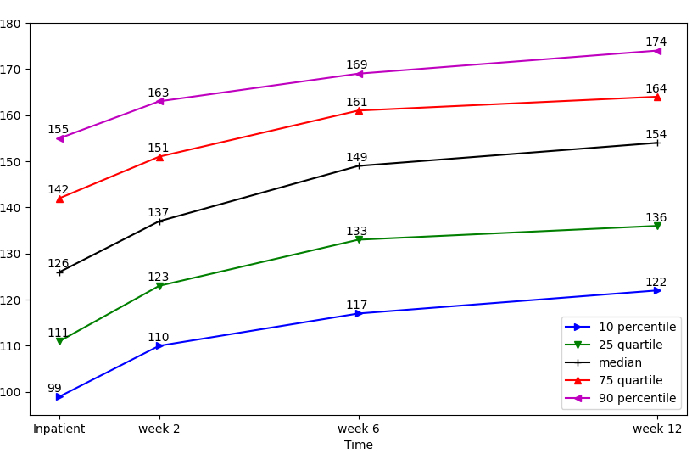
Results
Recruitment
Patient characteristics
Total STORK scores
Brigham and Women’s
N=162
Stanford
N=107
Northwestern
N=229
Variable | n=498
Age (y) | 33.3±4.9
Racial group
Asian | 15%
Black | 8%
White | 51%
Other | 5%
Gestational age (wk) | 39.2 [38.2, 39.6]
Primiparous | 46%
Delivery mode
SVD | 52%
OVD | 3%
Scheduled CD | 27%
Unscheduled CD | 18%
ASA grade
1 | 2%
2 | 81%
3 | 17%
Baseline:
N=498
Week 2:
N=357 (72%)
Week 6:
N=324 (65%)
10th percentile
25th percentile
Median
75th percentile
Week 12:
N=277 (56%)
90th percentile
Overall scores increased up to 12 weeks postpartum
SVD: spontaneous vaginal delivery; OVD: operative vaginal delivery; CD: caesarean delivery

Slide 4
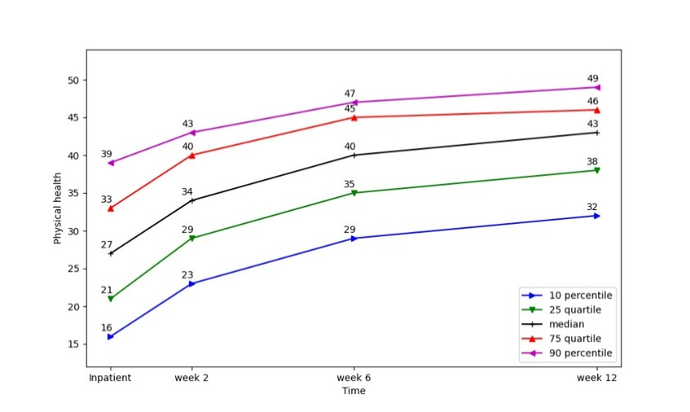
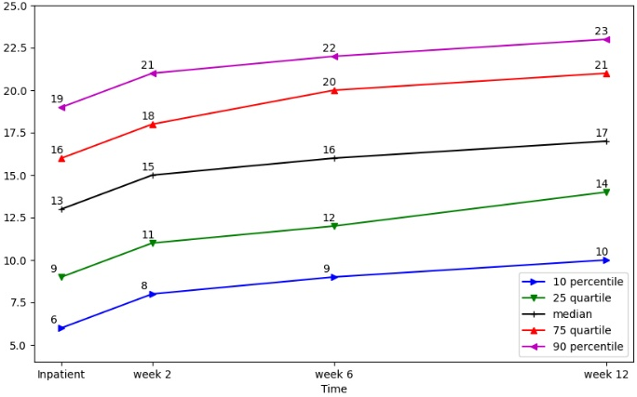
Results
Physical health, and Sleep & Fatigue scores improved up to 12 weeks postpartum
*
*
*
*
*
*
90th percentile
75th percentile
Median
25th percentile
10th percentile
*p<0.001
*p<0.001
Physical health
Sleep & Fatigue
Sleep & Fatigue
Mental health, and Motherhood experience & Social support scores improved up to 6 weeks postpartum
Notes:
Likely clinically sig diffs in physical from IP to week 2 and week 2 to week 6
And for sleep from IP to week 12
Mental health, and Motherhood experience & Social support scores improved up to 6 weeks postpartum
MH&MESS
______________________________
inpatient vs week 2 and week 2 vs week 6; p<0.001
Between 6 weeks and 12 weeks for M&EH: p=0.095
Between 6 weeks and 12 weeks for ME&SS: p=0.111

Slide 5
Results
Comparison between delivery modes
Comparison between primiparous and multiparous patients
Overall STORK scores
 | SVD | OVD | Scheduled CD | Non-scheduled CD | p-value
Inpatient | 130 [113, 147] | 119 [110, 133] | 123 [107, 137] | 123.5 [108, 140] | 0.004*
Week 2 | 139 [124, 152] | 130.5 [120, 137] | 135 [124, 149] | 134 [123, 152] | 0.26
Week 6 | 149 [132, 161] | 145 [133, 156] | 148.5 [134, 162] | 149 [133, 65] | 0.92
Week 12 | 155 [137, 163] | 156 [145,164] | 157 [138,166] | 148 [131, 165] | 0.57
*
*
*
*p<0.001
SVD: spontaneous vaginal delivery; OVD: operative vaginal delivery; CD: caesarean delivery
Scores given as Median [IQR]
Comparison between best and worst scores
Inpatient
Week 2
Sleep and fatigue demonstrated the greatest % difference in median scores between the high and low quartiles
48-56% difference
Notes:
For delivery mode:
There was a significant diff in overall STORK scores at inpatient timepoint.
SVD demonstrated the highest scores, and OVD associated with worst scores out of the delivery modes.
CLICK:
Significant difference in IP setting was driven by physical recovery scores and sleep and fatigue scores.
CLICK:
At week 2, physical health was significantly different between delivery modes. Again, scores were highest with SVD, and lowest with OVD
CLICK:
When scores were compared between primips and multips, overall scores were significantly different at IP setting, week 2 and week 6.
CLICK:
Significant difference in IP setting was driven by physical health and motherhood experience.
CLICK:
Significant difference at week 2 was driven by motherhood experience and mental health
CLICK:
Likewise, for week 6.
CLICK:
Sig diff at week 12 was driven by mental health and physical health.
CLICK:
When the top quartile of overall STORK scores were compared with the lowest quartile of STORK scores, lowest quartile of overall scores at each time point demonstrated significantly lower scores for each domain (p<0.001).
Sleep and fatigue demonstrated the greatest % difference in median scores between the high and low quartiles at each time point.
CLICK:
48-56% difference in sleep and fatigue scores
Week 2 postpartum:
Physical health scores significantly different (p=0.001)
Lowest: OVD ; Highest: SVD
Week 6 and 12
No significant differences
______________________________

Slide 6
Discussion
Recovery continues beyond 6 weeks postpartum
Multiparity and SVD associated with best recovery scores
Application: Monitoring, measuring impact of interventions
Thank you
Special thanks to our collaborators and participants in the development of the STORK measure, including:
Guo N, Leonard S, Fiore JF Jr, Domingue B, Khorasani E, Jensen S, Pandal P, Murthy A, Ansari J, Barwick F, Brookfield K, Carmichael S, Coker J, El Sayed Y, Flood P, Fowler C, Kawai M, Lyell D, Moreno C, O’Carroll J, Sharawi N, Sultan E, Whittington J, Yun R and Carvalho B
Next steps
Minimal clinically important differences
Trajectory analysis
Understanding drivers of worse recovery within each domain
Contact us
Limitations
Significant differences between respondents and non-respondents
Recruitment limited to 3 academic US centers
References
Sultan et al. Development and validation of the STanford Obstetric Recovery checKlist (STORK): A delphi consensus and multicenter clinical validation study, JAMA (in press)
Trost S, Beauregard J, Chandra G. Pregnancy-Related Deaths: Data From Maternal Mortality Review Committees in 36 US States, 2017-2019. Centers for Disease Control and Prevention, US Department of Health and Human Services; Published online 2022.
Hoyert DL. Health E-Stat: Maternal Mortality Rates in the United States, 2022.; 2024. doi:10.15620/cdc/152992
Notes:
Our results suggest that postpartum recovery continues up to and beyond the 6 week follow up period, which is traditionally used in the US for obstetric follow up.¹³
A quarter of parturients return to work within 10 days postpartum and this figure increases to 49% by 6 weeks post-partum.¹
In 2018, the American College of Obstetricians and Gynecology (ACOG) recommended a change in postpartum care, from an arbitrary 6-week review to a more personalised program with continued recovery and support beyond 6 weeks postpartum and a comprehensive assessment no later than 12 weeks postpartum.¹³ Identification of individual domain scores which correspond to adequate physical recovery, and sleep and fatigue may help guide physicians when advising their patients regarding resumption of tasks such as driving or return to work.
Overall inpatient postpartum recovery and sleep and fatigue was better following SVD compared to OVD, and physical recovery scores were better following SVD compared to OVD up to week 2 postpartum. Multiparity was associated with better overall recovery up to week 6 postpartum, which is consistent with previous studies
Application:
to identify patients scoring poorly that may potentially benefit most from referral and interventions to improve recovery, and could be used by patients to track their own recovery compared to their peers. facilitate a tailored approach to outpatient postpartum management.
CLICK:
Next steps include:
Establishing the MCID to help inform screening and referral thresholds
cut-offs for patients that may benefit most from early interventions and improving recovery trajectory with intervention need to be elucidated. Cut-off values used to trigger clinical referral must balance increased provider workload and staffing costs against the potential to improve patient outcomes and morbidity.
Determining trajectories of recovery within individual domains may help to guide clinicians regarding optimal timing for postpartum interventions.
Additionally, understanding the components of each recovery domain which are contributing to worse recovery can also help guide development of interventions.
CLICK:
Limitations;
Response rates were good (65%) at 6 weeks. However, non responders differed to responders in terms of their demographics and clinical variables, including employment status, education, racial group, delivery mode and parity. It is unclear whether these patient groups would have scored significantly differently compared to the respondents.
patients were only recruited from 3 academic US centers. Further studies are therefore needed to evaluate STORK in rural, private settings and in other US states, other countries and in other healthcare systems.
Patients who are non-English speaking should be invited to complete translated versions to see if the PROM remains valid, reliable and responsive. We are currently working with collaborators in Asia, Europe and South America to translate and validate STORK in over 5 different languages and evaluate its performance in a racially, ethnically and culturally diverse postpartum populations.
CLICK:
I would like to thank our collaborators and participants in the development of the STORK measure. I would like to give a particular thanks to PS for his invaluable guidance and leadership throughout this project.

Slide 7
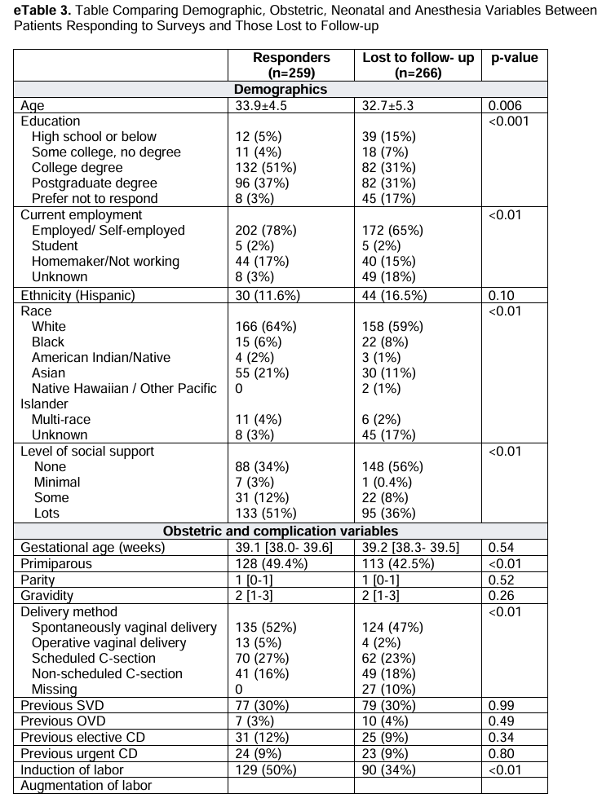
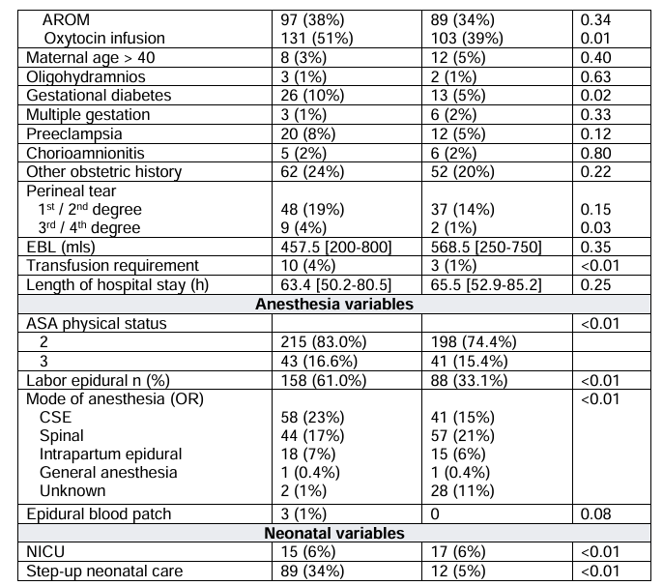
Possible questions
MCID estimates
Lost to follow up
Sociodemographic
Obstetric
Infant
Notes:
MCID:
SVD vs CD: we know that they have significant difference recovery based on previous studies examining postpartum recovery scores as inpatients with ObsQoR10 scores. Overall STORK score at inpatient for SVD was 130 overall vs 123 for CD. Suggests that difference of 7 points in STORK scores is clinically significant.
When comparing parity, median overall STORK scores were 4 points less than multips at the inpatient time point. It us unlikely that this is clinically significant. However, there is a difference of 6-7 points at week 2 and week 6 postpartum between the two groups. This could indicate a clinically significant difference at these time points.

