Slide 1
Strategies for disaster preparedness and planning for peripartum healthcare delivery: A scoping review
C. Poirier, MDCM, M.Sc.
M. Wong, FRCPC
J. Barrera, FRCPC
A. Chau, FRCPC
P. Sultan, MBChB, FRCA
G. Abir, MBChB, FRCA
K. Chawla, MD, FACOG
K. Fong, FRCA
H. Scott, MD, FRCSC
R. George, FRCPC
H. Wu, MSI
K. Joudi, MSI
J. Ke, FRCPC

Slide 2
Introduction
Vulnerability of peripartum patients during natural disasters
Increased complications Lack of coordinated care
Aim: to explore literature on disaster planning strategies for peripartum healthcare delivery
Notes:
Natural disasters significantly disrupt healthcare systems.
E.g., infrastructure damage, loss or depletion of medical supplies, and an overwhelming demand for emergency care
Pregnant individuals are particularly vulnerable due to the critical nature of perinatal care.
Average death ratio of females to males in areas affected by natural disasters is appr. 3:1
Increased pregnancy complications and adverse maternal/neonatal outcomes, including miscarriages, preterm births, infection rates, low birth weight, and maternal stress-related conditions
Lack of structured frameworks for peripartum care, particularly the role of anesthesiologists, in existing disaster-response guidelines
Ultimate goal: to inform future policy, multidisciplinary practice guidelines, and educational efforts

Slide 3
METHODS
Inclusion criteria: patients ≥ 18 years who received perinatal care during natural disaster.
English full-texts, 2003-2024
Thematic and deductive analysis:
Disaster planning phases: mitigation, preparedness, response, recovery
Healthcare delivery domains: capacity, organizational structure, finances, patients, care processes and infrastructure, culture
Notes:
Scoping review based on Joanna Briggs Institute methodology and PRISMA-ScR
Search strategy: articles published in PubMed MEDLINE, EMBASE, EBSCO CINAHL, Web of Science, and the Cochrane Database of Systematic Reviews, grey literature review.
*published within the past 20 years

Slide 4
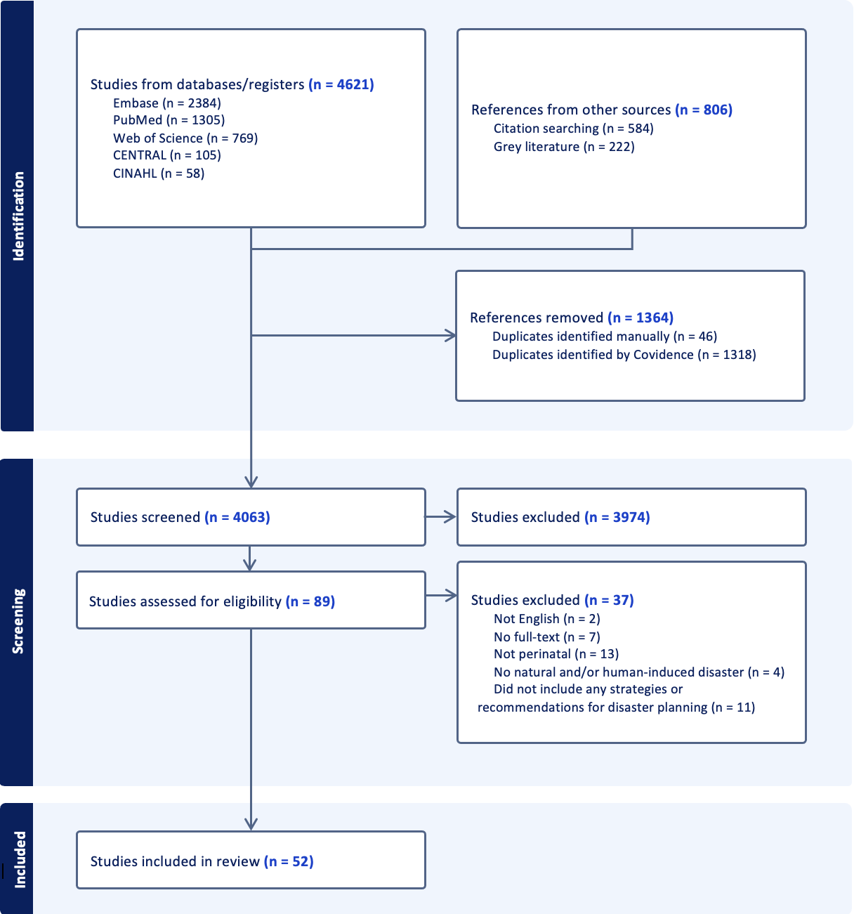
Results
Disaster planning stages:
Mitigation
Preparedness
Response
Recovery
Healthcare domains:
Capacity
Organizational structure
Finances
Patients
Care processes and infrastructure
Culture
Strategies:
Triage protocols
Multidisciplinary teams
Mobile health units
Equipment checklists
Interdisciplinary simulations
Notes:
15 countries
Disaster types: COVID-19 pandemic (35%), general natural disasters (28%), earthquakes (21%), hurricanes (7%), floodings (4%), influenza pandemics (4%), and less frequently, tsunamis, Zika, Ebola, and manmade disasters (2% each)
4 stages of disaster planning addressed: mitigation (25%), preparedness (34%), response (31%) and recovery (12%)

Slide 5
Conclusion & discussion
Challenges:
Resource allocation and supply shortages
Disruptions in infrastructure
Internal displacement
Health inequities
Limitations:
Lack of standardized terminology
Heterogeneous studies and methods
Limited generalizability
Grey literature and unpublished data
Rapidly evolving field
Next steps:
Obstetric-specific protocols
Standardized terminology
Interdisciplinary simulations
Consensus guidelines
Notes:
Key strategies identified: triage and management protocols tailored for peripartum care, formation of obstetrical multidisciplinary teams, use of mobile health units for rapid deployment, equipment checklists, and interdisciplinary training simulations
Challenges identified: resource allocation, disruptions in infrastructure, particularly in low-resource settings

